Slide 1
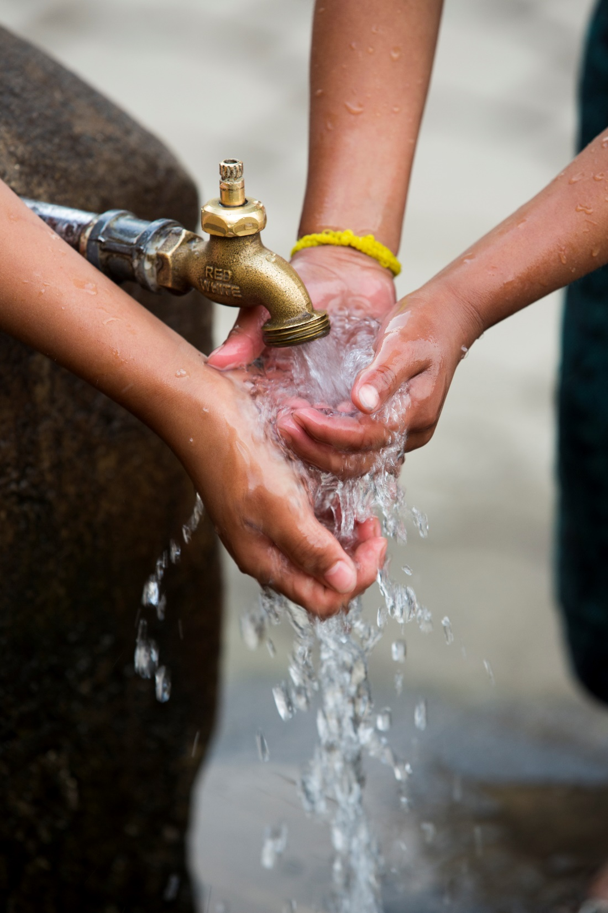

The Rotary Foundation
District Grants 2019/20
Elizabeth Tollis
Notes:
The process of applying for Global Grant has been significantly simplified.
Let’s do a quick run-through of how it works.

Slide 2
Summary of District Grant Applications:
11 clubs in our district are receiving 12 grants in current year.
9 were for local community projects.
3 were for projects in Bali, Kenya & Uganda
New applications will close on 31 October 2020. DGE Debbie is keen to promote international projects but it is up to each club.
Have US $30,500 or about AUD$45,000 available - grants of up to $4,000.

Slide 3
Tamworth
Help 10 young adult migrants in local area
Providing bicycles, helmets and bike locks.
Transport for employment
Help with socialisation
Requested and received $2000

Slide 4
Narrabri
Help for Katooga village Uganda
Providing stormwater drainage and sanitation
Preventing diseases such as cholera typhoid and malaria
Requested $6000 and received $6900 for project of $16,884

Slide 5
Armidale AM
Help for palliative care ward of Armidale Referral Hospital
Providing chairs and tables for balconies
Requested $4000 and received $4600 for project of $6000

Slide 6
E club
Help for Ebor public school
Providing obstacle style course in school grounds
Requested $1000 and received $1150 for project of $1250

Slide 7
Woolgoolga
Help for Mullaway primary school
Providing Stage 1 of a sensory playground
Aim to stimulate outdoor imaginative play using appropriate surfaces objects and plants
Requested $4000 and received $4600 of project $5500

Slide 8
Wauchope
Help for Salam Children’s Home at Tabannan, Bali
Providing cost effective and sustainable food production
Home provides these children with shelter, clothing, food and assists with education costs.
Requested $3794 and received $2417 of total $3994

Slide 9
Sawtell
Help for 7 local primary schools
Providing quality Australian readers for Early Readers Literacy Project
Support literacy in young people
Requested $1525 and received $1725 of total $3050

Slide 10
Port West
Help for East Assembo Kenya
Providing WASH project (Water Sanitation and Hygene in schools)
Also providing clean drinking water
Requested $3000 and received $3000 of total $3000

Slide 11
Port
Help for Port Base Hospital – Mental Health Unit
Providing outdoor sensory garden
Aid patient recovery and & rehabilitation
Requested $3000 and received $3450 of total $3500

Slide 12
Port
Help for Hastings Secondary College
Providing STEM/Robotics equipment
Help students develop skills for jobs which don’t now exist
Requested $5000 and received $5750 of total $20,000

Slide 13
Laurieton
Help for local Social Senior Citizens group
Providing 8 folding wheeled tables
Enabling easy storage & movement
Requested $3000 and received $3450 of total $4500

Slide 14
Bellingen
Help for local community
Providing defibrillators
Assist those suffering cardiac arrest
Requested $6000 and received $6900 of total $8042

Slide 15
Applications 2020/21
Open 1 July 2020
Close 31 October 2020
Download form D website
Send Elizabeth Tollis
1 applic per club
Notes:
The process of applying for Global Grant has been significantly simplified.
Let’s do a quick run-through of how it works.

Slide 16
Applications 2020/21 (cont)
Max $4,000
Club must be qualified
US $30,552 available
About AUD $47,000 as at now
Must report at end
Notes:
The process of applying for Global Grant has been significantly simplified.
Let’s do a quick run-through of how it works.

