Slide 1
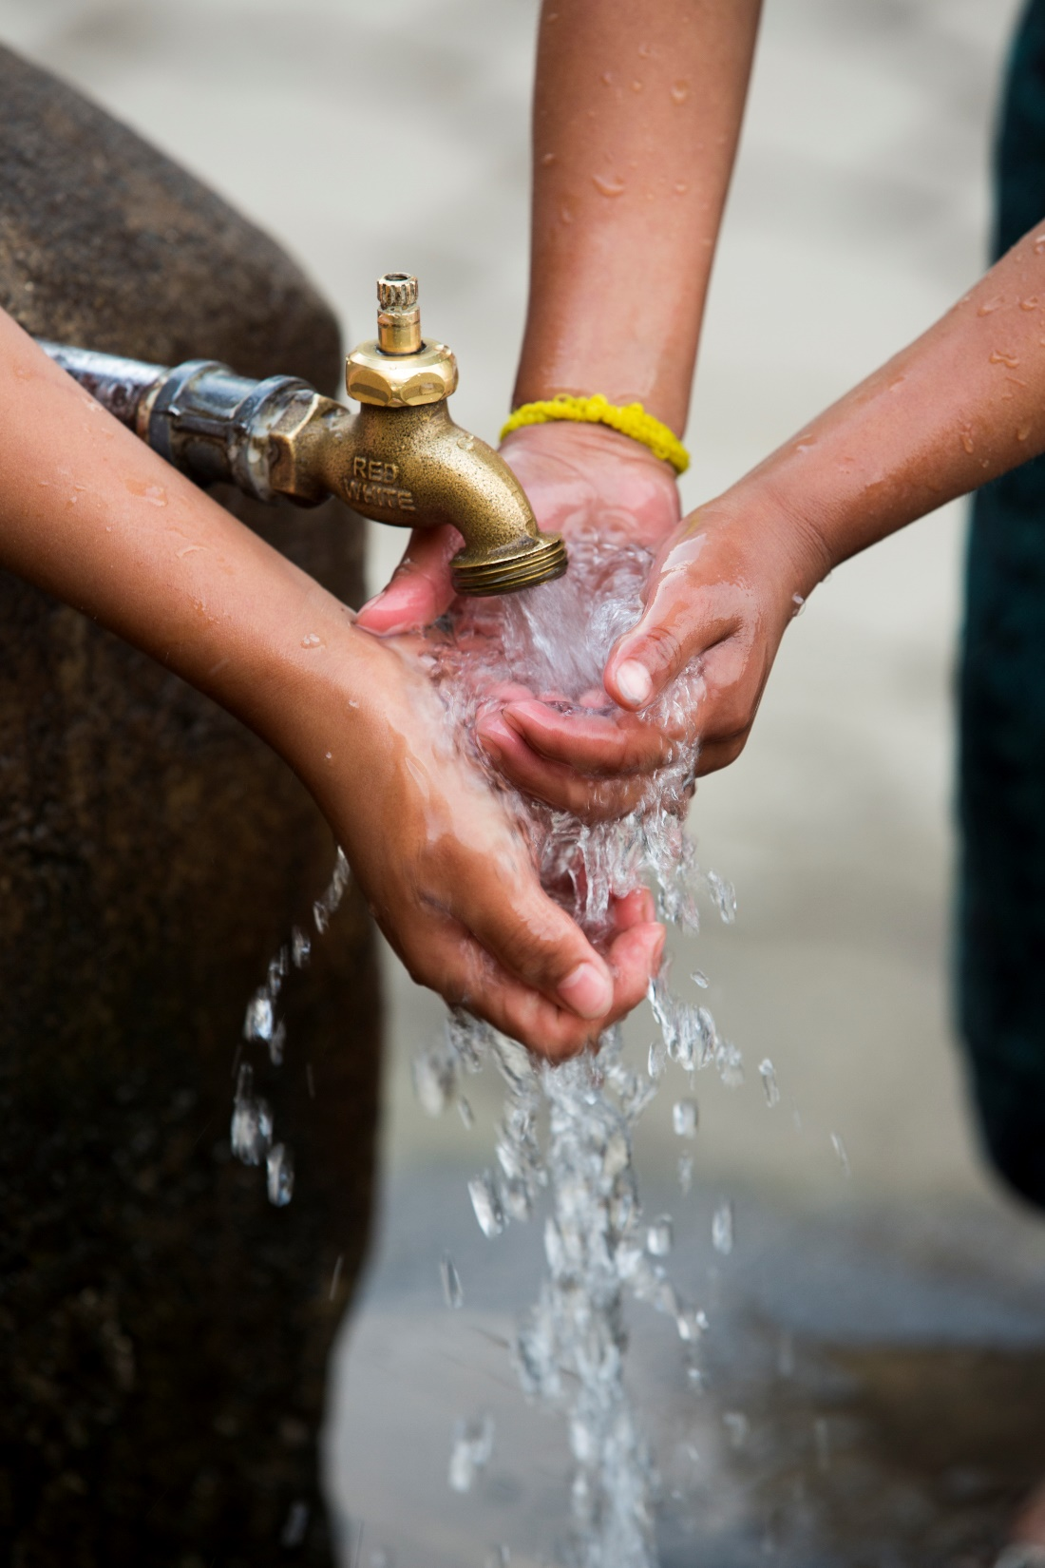

The Rotary Foundation
Global Grants 2020
Greg Moran
Notes:
The process of applying for Global Grant has been significantly simplified.
Let’s do a quick run-through of how it works.

Slide 2
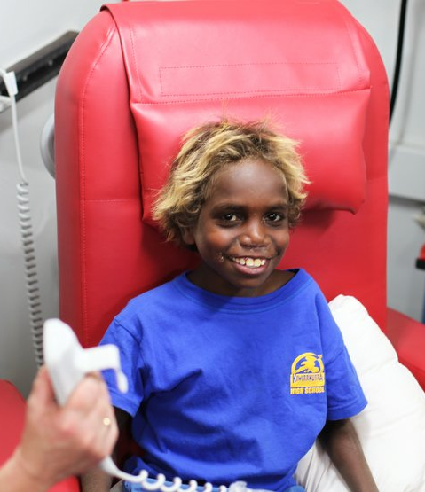
GLOBAL GRANTS
Large (US30K+), long-term
Sustainable, measurable
Align with an Area of Focus
International partnership
World Fund funding
HQ approval
funded from World Fund.
Notes:
Global grants support large international activities with sustainable, measurable outcomes in Rotary’s Areas of Focus.
A key feature of global grants is partnership, between the club or district where the activity will occur and a club or district in another country.
The Foundation’s World Fund provides a minimum of $15,000 and maximum of $200,000 in funding.
District Designated Funds are matched at 100% and cash is matched at 50%.
The child in this photo no longer has to travel over a thousand kilometres to receive dialysis treatment – thanks to a new clinic in the north-west of South Australia, funded with the assistance of a Global Grant.

Slide 3


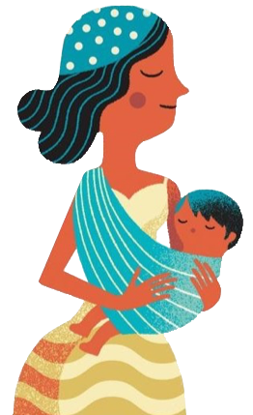



AREAS OF FOCUS
—our causes —
disease prevention
and treatment
peace and conflict
prevention/resolution
maternal and
child health
water and
sanitation
economic and
community
development
basic education
and literacy
Notes:
Global grants must support at least one of Rotary’s six areas of focus, which reflect critical humanitarian needs that Rotarians are addressing worldwide.

Slide 4
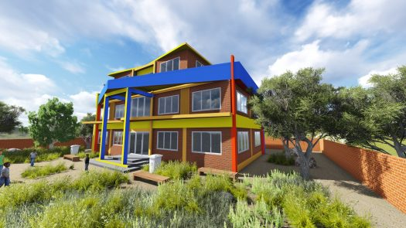
Maternity Hospital in Dolakha - Nepal
Mothers and Babies Hospital

Slide 5
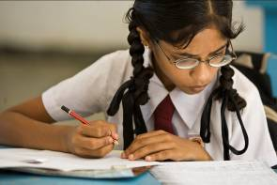
Maternity Hospital in Dolakha - Nepal
Dr Ray Hodgson, Port Macquarie club, taking medical teams to Nepal since 2011
A Mothers and Babies Hospital to be built in district Dolakha, eastern Nepal
Highest rate of pelvic floor collapse in world
Foundation doesn't build hospitals …but
Funding from Foundation for hospital equipment
Foundation has now approved AUD $350,000
Biggest grant our District has ever received
To go temporarily into nearby hospital where Ray works

Slide 6
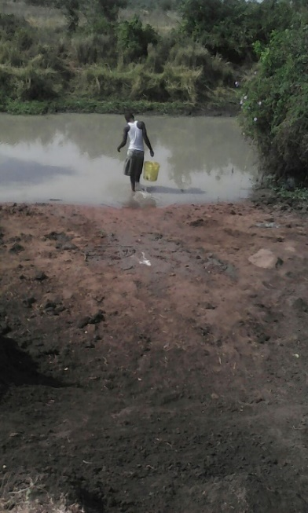
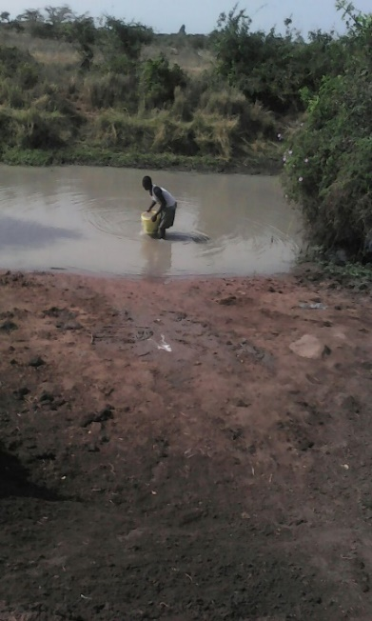
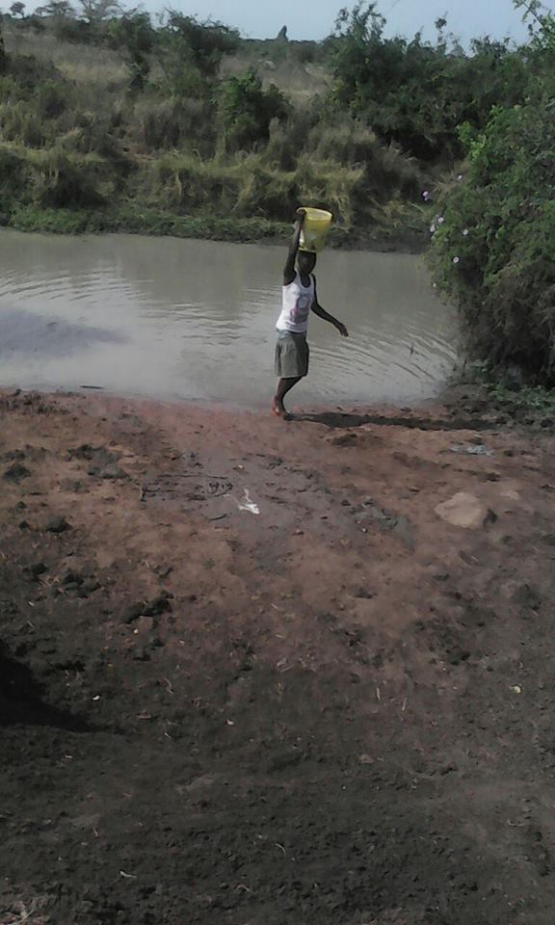
Masala Village Water Project

Slide 7
Masala Village Water Project
Mutuoto Kigotho - Armidale AM
Working with Paul Ogunyah teacher from Sydney
Paul was born in Masala village – visits regularly
6,000 people in local area rely on a river 2kms away
Project is to drill bore; solar powered pump; water tank – budget US $55,128
Save women particularly from daily carrying water

Slide 8
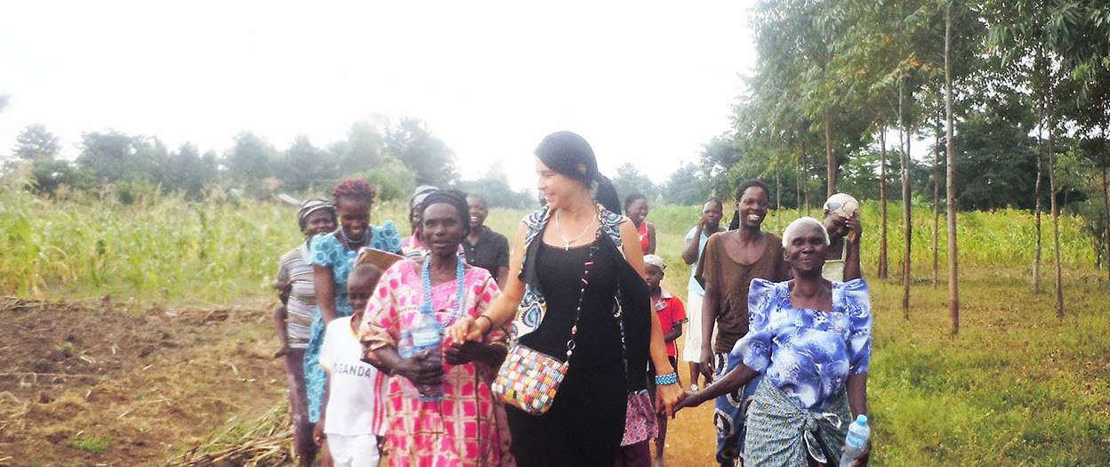
Little Blue Shed Project – Uganda

Slide 9
Little Blue Shed Project – Uganda
Tanya Curcic – Taree Club/Uganda
Turning vulnerable women in rural Uganda into entrepreneurs – budget US $35,675
Making products – handbags, purses, necklaces, bracelets, earrings etc
Using beads - 100% recycled calendar paper
Training 6 women leaders 120 beneficiaries
Training in business skills & entrepreneurship
Empowering women in poor countries

Slide 10
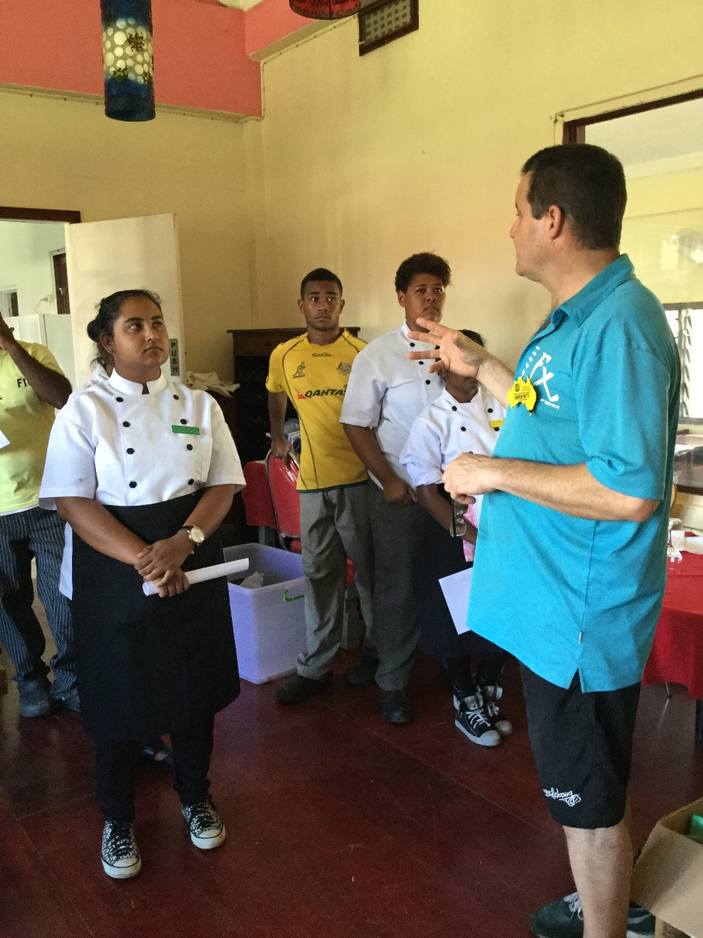
Future Learning in Fiji

Slide 11
Future Learning in Fiji
Veena Tilley from Nambucca Club
12 years ago - team to Fiji to build a home
Visited local school at Drasa
Headmaster’s dream - a library – built next year
12 years – libraries/computers/hospitality - 20 schools
Project
Drasa Charmer School of Hospitality in Lautoka
Extension to existing facilities
VTT to Fiji - training teachers
Teacher scholarship in Managing Kitchen Operations.
Budget US $33,136

Slide 12
St Mary’s Hospital - Kokopo PNG
Dr Robert Sharp of Tamworth First Light
Born in area of Kokopo PNG – visits reg
Preventable diseases increasing in PNG
Practices at Kokopo Hospital are 3rd World
Aim to bring to 1st world standard
Dr Rob and nurses plan to work with hospital staff and board
Project is to fund necessary equipment
Club will provide US $28,000 of US $46,000 project

Slide 13
St Peters Secondary School Viragalar India
Gordon Fuller – Uralla – US$30,000 project
Lyn and Greg McLenahan – visiting school often
Horrified lack of resources for 850 boys and girls
Project is to provide 25 kv generator, whiteboards, more computers, projector, outdoor shade area, library furniture, air conditioning, fans, lab equipment, sports gear.
Fell over but became a RAWCS project

Slide 14
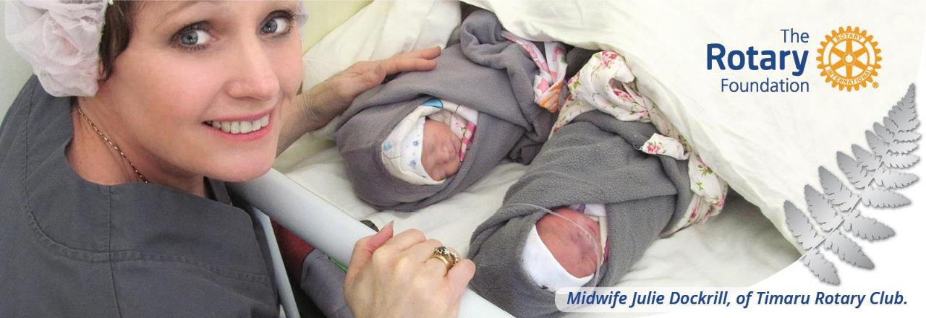
2.
Group of professionals who travel, in order to:
  Learn about their vocation
  Teach professionals about a particular field
  Strengthen knowledge and skills.
Vocational
Training
Teams
Notes:
Second is Vocational Training Teams
These teams are groups of professionals who travel, either to learn more about their vocation or to teach local professionals about a particular field. These teams can expand the knowledge and skills of individuals and communities.
The vocational training team concept was inspired by the successes of past grant programs, including Group Study Exchange and Volunteer Service Grants.
Rotary clubs and districts can support vocational training teams through District Grants or Global Grants.

Slide 15
Vocational Training Team in Dhulikhel - Nepal
DGN Debbie Loveday – Port
Training team will address lack of surgeons able to conduct prolapse surgery, by giving practical demonstrations of this type of surgery, instruction to surgeons wanting to carry out this surgery, examination of said surgeons to ensure sustainability after training team has left.
Lack of midwives able to perform ultrasound to detect mothers and babies at risk. Training and education will be given and knowledge and practical skills assessed at the end of the training visit.

Slide 16
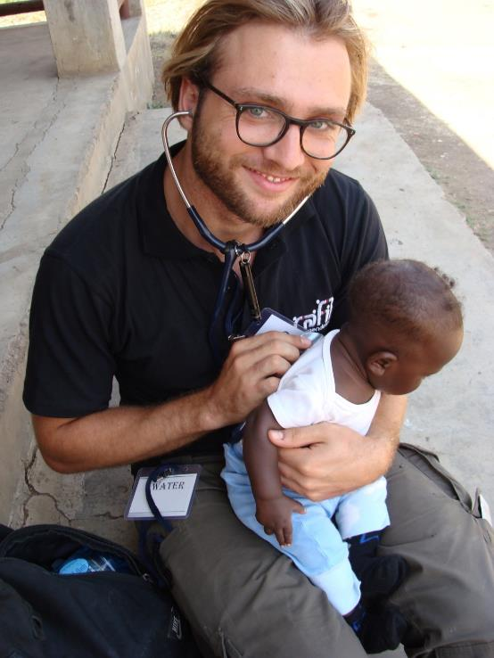
3.
GLOBAL GRANT
SCHOLARSHIP
Notes:
Third is Global Grant Scholarships.
Rotary clubs in Germany and England worked together to provide a global grant scholarship to Dr. Sven Jungmann, who received a Master of Public Policy at Oxford University in England.

Slide 17
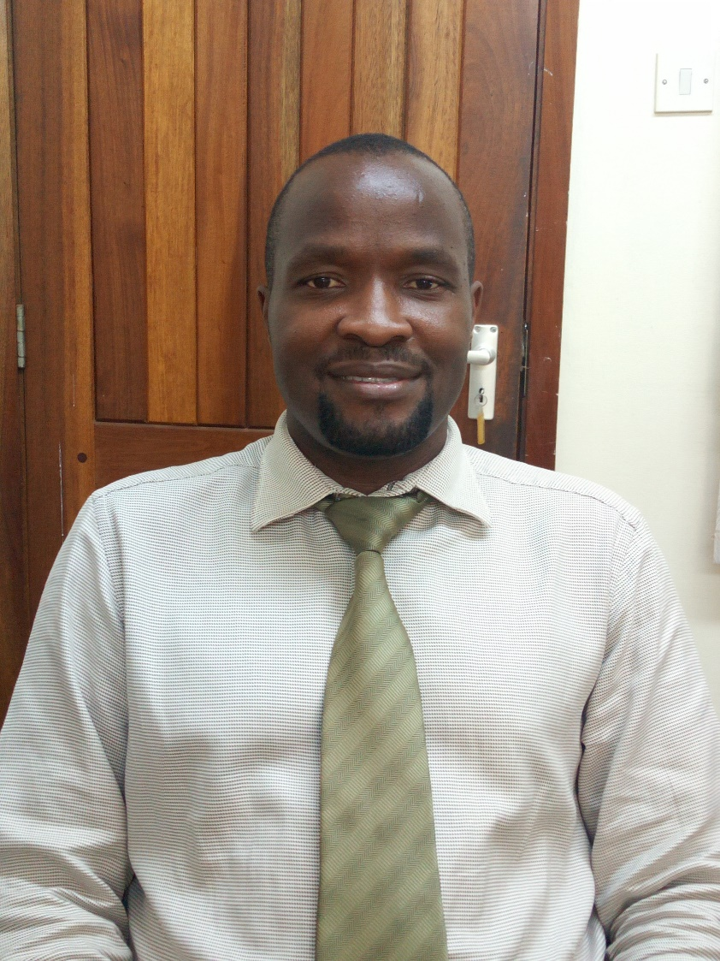
Dr Michael Ssonko– Uganda

Slide 18
Dr Michael Ssonko– Uganda
GSE Team visit to Taree from Uganda 2018
Taree on Manning now seeking scholarship for Dr Michael Ssonko from Uganda to become country’s first geriatrician - Budget US $97,373.
Accepted into University of Cape Town.
Post Graduate course in Geriatrics.
Over 31 months.
Ultimate intent to establish multidisciplinary geriatric medicine service at National Referral Hospital in Uganda – 1st for Uganda!

Slide 19
GLOBAL GRANTS 2020/21
US $59,567 available in 2020/21 for Global Grants
We commonly grant US $10,000 for good projects
Matched by US $10,000 from World Fund
Minimum size project US $30,000 (AUD $46,000)
Club funds matched 1:2 so club must raise US$6667
Equiv about AUD $10,000
Notes:
Global grants support large international activities with sustainable, measurable outcomes in Rotary’s Areas of Focus.
A key feature of global grants is partnership, between the club or district where the activity will occur and a club or district in another country.
The Foundation’s World Fund provides a minimum of $15,000 and maximum of $200,000 in funding.
District Designated Funds are matched at 100% and cash is matched at 50%.
The child in this photo no longer has to travel over a thousand kilometres to receive dialysis treatment – thanks to a new clinic in the north-west of South Australia, funded with the assistance of a Global Grant.

