Slide 1

Why Support the Rotary Foundation?
Maurie Stack 2020

Slide 2
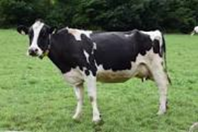
Milk the Cow?
Then Feed the Cow

Slide 3
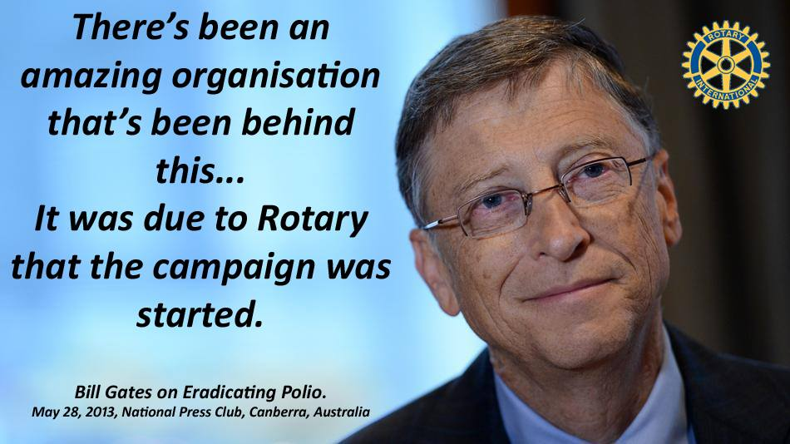
2. Contributions can be value added by:
World Fund matching
Corporate partners
Government sponsors
Community groups
Private contributions

Slide 4
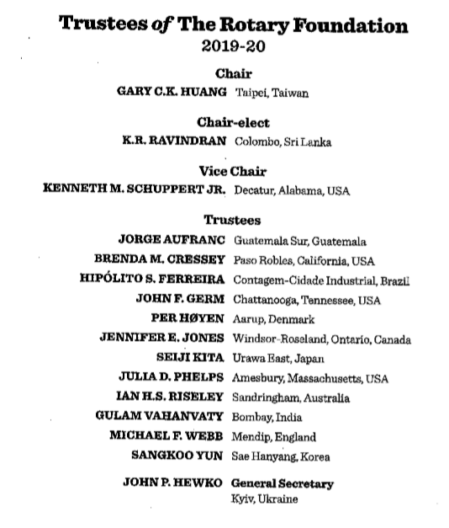
  3. TRF belongs to and is managed by Rotarians
Regional Rotary Leadership Team
District Rotary Leadership Teams
Club Rotary Leadership Teams
Regional Office Support Staff

Slide 5
  4. It focuses on six areas identified by Rotarians
Peacebuilding and Conflict Prevention*
Disease Prevention and Treatment
Water, Sanitation, and Hygiene*
Maternal and Child Health
Basic Education and Literacy
Community Economic Development*
Notes:
Whether it’s eradicating polio in India, digging water wells in the Philippines, providing dictionaries to a local elementary school, or educating a scholar in peace and conflict resolution, Rotary creates the environment and circumstances to promote peace throughout the world.
So I ask you, what makes Rotary special?
[Encourage Audience Participation]
The Rotary Foundation
-Addresses all of the greatest educational and humanitarian needs
-Its world reach is greater than the United Nations
-We can go where politicians and religious groups cannot
Thank you for your comments. I encourage you to share your stories with your fellow Rotarians, and with The Rotary Foundation – so we may share them with the world.

Slide 6

  5. TRF is financially efficient …..
Notes:
Also fir in with UN Sustainable Development Goals

Slide 7

…… transparent and accountable

Slide 8

  6. To support Rotary’s signature project –
  polio eradication
1988
350,000 WPV cases
Remaining polio-endemic countries:
  Afghanistan
  Pakistan
2019
164 WPV cases

Slide 9

  7. To leave a legacy of ‘doing good in the world’

Slide 10




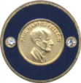

8. Donor Recognition Opportunities
Individual
Club
EREY
Paul Harris Fellow
Paul Harris Society Member
Major Donor
Bequest Society Member
Arch Klumph Society Member

Slide 11
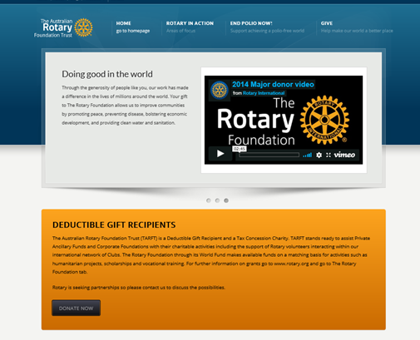
  9. Tax incentives for individuals and corporates

Slide 12
  10. It is in the constitution of every Rotary club
Club Constitution
The purposes of this club are to pursue the Object of Rotary, carry out successful service projects based on the Five Avenues of Service, contribute to the advancement of Rotary by strengthening membership, support The Rotary Foundation, and develop leaders beyond the club level.

