Slide 1
A program for ALL Rotarians to demonstrate their support for
The Rotary Foundation

Slide 2
The Every Rotarian Every Year initiative asks every Rotarian to support The Rotary Foundation every year. In addition to contributing to the Annual Fund on a regular basis, members are encouraged to get involved in a Foundation project or program.
In Australia and New Zealand this program is known as the Centurion Program where the ask is to contribute $100 in local currency value to support the Annual Fund of The Rotary Foundation.

Slide 3

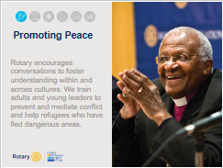





Slide 4
Contribution Trends - Australia

Slide 5
Contribution Trends – New Zealand

Slide 6
Club v Personal Giving 16-17

Slide 7
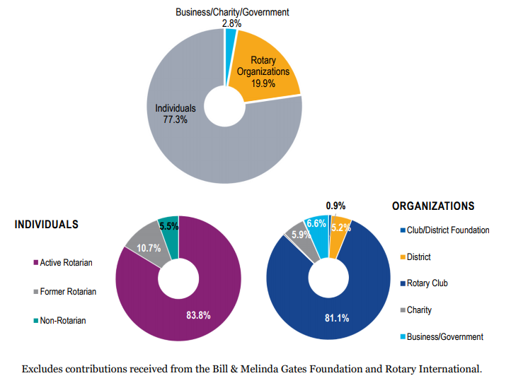
Contributions by Source to TRF - Global

Slide 8
EREY (Centurion) Donors by District 16-17

Slide 9
Growing Engagement!
District Rotary Foundation Team
  DRFC – MUST HAVE
  Grants Chair- MUST HAVE
  Stewardship Chair – MUST HAVE
  Annual Fund Chair – (Centurion)
  Paul Harris Society Chair
  Polio Chair
  VTT Chair
  Scholarships Chair
  Peace Scholarships Chair
  Endowment Fund Chair

Slide 10
Annual Fund Chair - Role
Annalise Club participation levels
Contact Club Foundation Chair
Discuss Foundation Goals (or lack of)
Request a Club visit to speak on EREY
Present the benefits of EREY
ASK for participation
Explain recurring giving
Distribute forms (and collect on the visit)
Submit forms to RISPPO
Track engagement

Slide 11
Growing Engagement!
During the presentation ask the following:
  Do you give to a particular charity on a regular basis?
  Have you ever investigated the administration costs of the charity that you give regularly to?
  Did you know that The Rotary Foundation is a charity?
  Did you know that TRF has one of the lowest administrative costs of any charity in the world?
  Did you know that giving to TRF is tax deductible?
  Would you consider giving to your charity TRF, on a recurring basis?

Slide 12

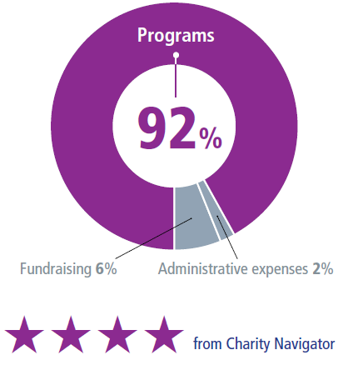
DOING GOOD IN THE WORLD
THE ROTARY FOUNDATION’S EXPENDITURES GO TO...
OUR LONG-TERM STRATEGY...
Ensure that we have sufficient funds to operate our Foundation
Maintain a fully funded operating reserve
Transfer surplus funds to the Endowment Fund
Notes:
Rotary’s unique funding model strengthens our future by building on a stellar record of efficient use and stewardship of the financial resources entrusted to us. For example, when we look at our annual expenditures over the last 10 years, we’ve minimized our fundraising and administrative expenses and dedicated 88 to 89 percent of our total spending to programs.
The Foundation’s sound financial management and its commitment to accountability and transparency are also recognized as exceptional, year after year, by independent evaluators of not-for-profits. Rotary’s website provides detailed information on the Foundation’s finances.
In fiscal year 2016-17, only 2 percent of Foundation expenditures went to administrative expenses and 6 percent to fundraising. The Foundation directed 92 percent of its spending to programs, far exceeding the benchmarks that independent charity-rating services view as a measure of high efficiency.
The recent recession demonstrated to the philanthropic community that maintaining a strong financial base that includes operating reserves is necessary in order to weather increased volatility in financial markets.
With a solid financial base and restored reserves, we’ll have an organization that is able to support the good work that Rotarians do in the world — even as the economic and financial environment remains unpredictable.

Slide 13





Growing Engagement!
EREY giving and recognition
  Annual Fund
  Polio
  Paul Harris Fellow Recognition
  Paul Harris Society
  Major Donor Recognition

Slide 14
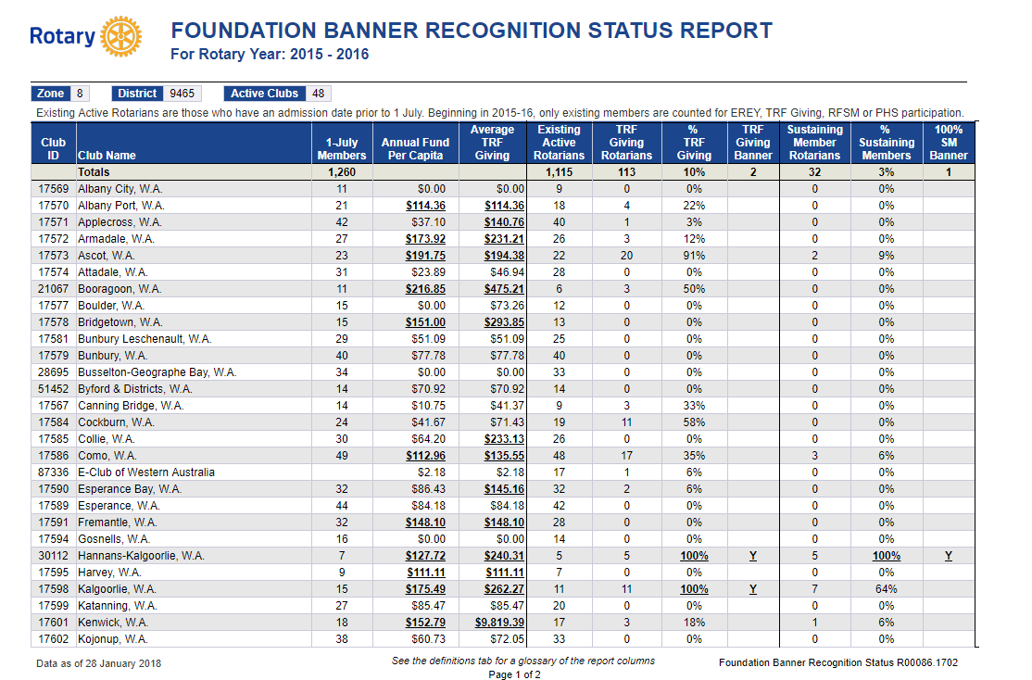

Slide 15
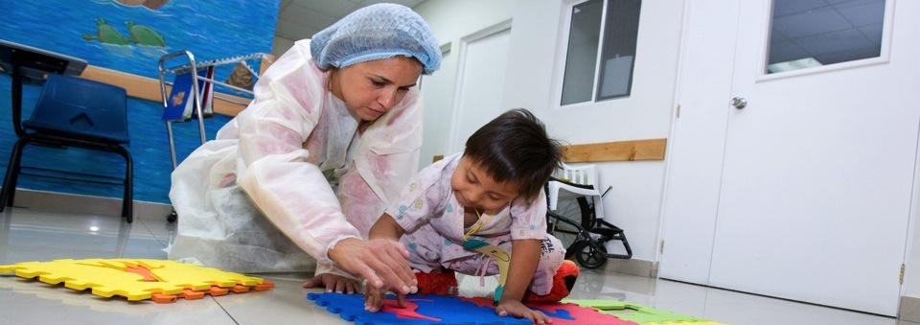
MAKE THE ROTARY FOUNDATION YOUR CHARITY OF CHOICE!
Needs identified and implemented by Rotarians
Global network of
compassionate volunteers
Rotarian driven
Local and international activities
Diligent oversight of funds
Notes:
The Rotary Foundation is YOUR Foundation – make it your charity of choice!
Rotarian driven projects— projects are created at the local level by Rotarians who live and see the needs of the community every day.!
Diligent Oversight of Funds: Rotary funding is monitored on many different levels. Funds are overseen by Rotarians, clubs, districts and Rotary staff. Larger projects are even reviewed and audited by Rotarian professionals that work within the area of focus and can give expert guidance and evaluations. Rotarian auditors sometimes perform audits to ensure spending is being used correctly. All of these measures ensure that the funds YOU give to The Rotary Foundation Do Good In The World.
Local and International Projects- Rotary helps people in need throughout the world. The SHARE system and grant model allow for projects to take place in your backyard or across the globe. The international component and ability to help those in need around the world is unique and Rotarians have made their Foundation extraordinary in its capacity to focus on needs in developed and developing countries!
Rotarians = Service above Self
Rotarians are The Rotary Foundation. Contributing to The Rotary Foundation each and every year is demonstrating your commitment to “Service above Self” and a commitment to helping those in need. Let’s take a look at what your contributions can do…

Slide 16
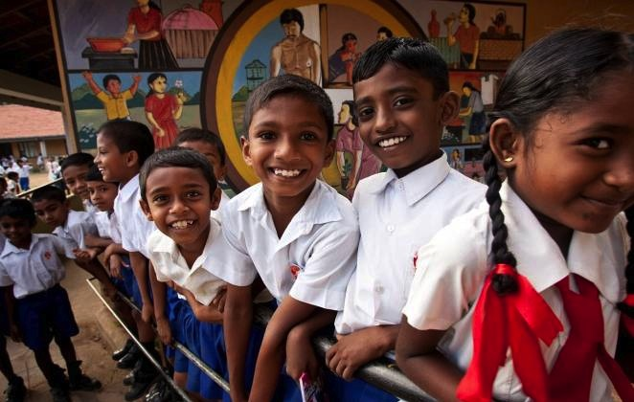

HOW WE FUND PROGRAMS – SHARE SYSTEM
50%
District Designated Fund (DDF)
50%
World Fund
Notes:
To review: when we contribution to Annual Fund – SHARE, fifty percent (50%) of our contributions come back to our district through District Designated Funds (DDF) in three years to spend on educational and humanitarian activities chosen by us; even grants that may be used for projects in our local community.
The 5 percent that is earmarked to potentially pay for the Foundation’s operating expenses will come from the World Fund. It will be used only if it is needed to pay expenses when net investment returns are not sufficient, or to fully fund the operating reserve (up to three times annual operating expenses). If funds are not needed for these purposes, they will remain in the World Fund until the World Fund is measured to ensure sufficient funds for programs.
In the final step, the World Fund will be measured to ensure that it contains 50 percent of the three prior years’ worth of contributions, plus $5 million – a growth factor. Then and only then, surplus funds will be transferred to the Endowment Fund.
This funding model:
Builds our financial strength by ensuring that resources are available to meet current needs: programs and operating expenses.
Establishes a reserve to provide for unusual financial events (a rainy day fund): the operating reserve.
Ensures an increase in future programs through increased returns on the Endowment Fund.

Slide 17


RECURRING GIVING : ROTARY DIRECT
    Safe, secure, and easy
    Give monthly, quarterly, or annually
    Enroll at www.rotary.org/give
    Use this form to enroll.
Notes:
One of the easiest and most secure ways for us to support our Foundation is through Rotary’s recurring giving program, Rotary Direct. Select an amount, frequency (monthly, quarterly or annually), and contribution method that is convenient for you.
Enrollment is integrated with the Foundation’s secure online contribution system and is available in multiple currencies.
Efficient, convenient and secure.
The Rotary Foundation will send you one annual statement of Rotary Direct contributions for tax purposes (where applicable).

Slide 18
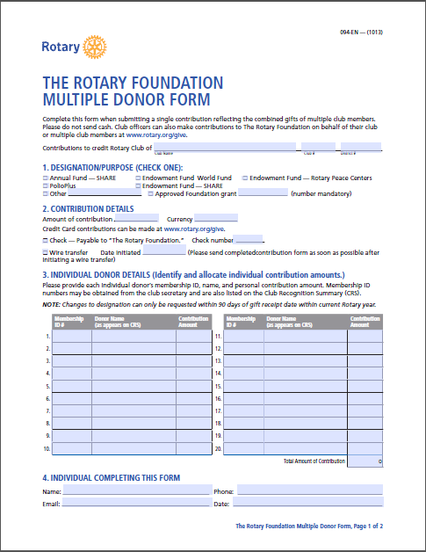

Ways to give – Club Multiple Donor Form
Give via your Club
Club lists member & member ID on form
Member gives to Club
Club sends form and one cheque
Each member receives a tax receipt
Mark this form Annual Fund Only

Slide 19
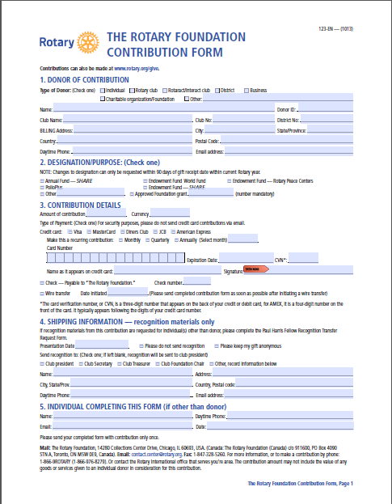

Ways to give – Give Directly
Give Directly
Register your annual giving with TARFT
Tick term box
Currency $100
Credit card or direct debit
Advise District Centurion Chair of your giving.

Slide 20
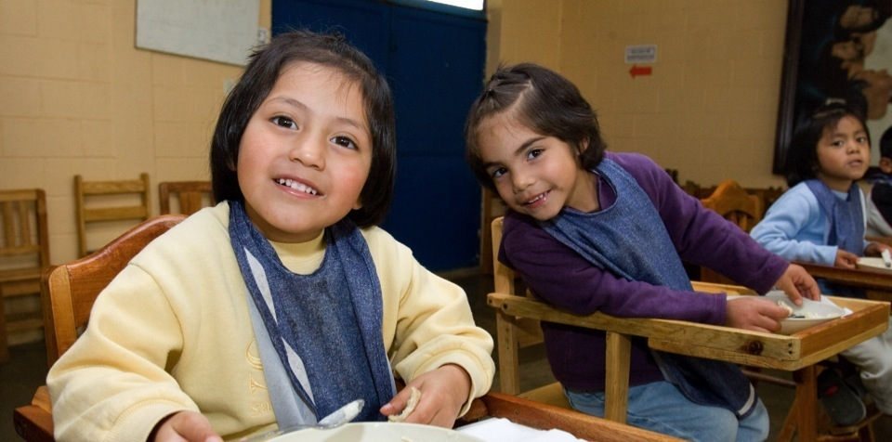
THANK YOU
www.rotary.org/give
Notes:
As a Rotarian, I hope you feel proud about what you are helping accomplish. I hope you now understand why every gift, from every Rotarian, does a world of good.
Please join ME and Every Rotarian in supporting OUR Rotary Foundation, Every Year.
Thank you.

