Slide 1


Celebrating 110 Years of Rotary
The Polio Campaign
30 Years

Slide 2

The beginning ...
1950’s, ‘60’s and ‘70’s, we who are old enough all knew someone who had contracted polio
350,000 cases world-wide every year - 50,000 deaths, the rest - crippling life-long disabilities

Slide 3
What is polio?
Polio, a highly infectious disease caused by a virus.
The polio virus invades the nervous system through direct person-to-person contact.
It moves through the phlegm or faeces of an infected person.
Three types of the wild virus, quite different from each other

Slide 4
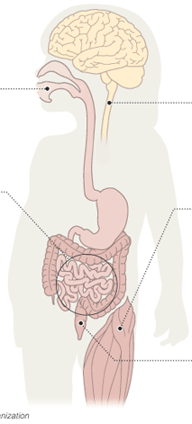
FINDING A VICTIM
The virus enters the body through contaminated food or water tainted with sewage
In less than 0.5% of cases the virus attacks the central nervous system destroying cells in the spinal cord
THE DAMAGE
Nerve cell death causes muscle paralysis mostly in the legs
SETTLING IN
It attaches to the intestinal walls, then gets into the bloodstream
MOVING ON
Even if people have no symptoms the virus is excreted in faeces which contaminates food and water
THE ATTACK
In 99.5% of cases, there are no symptoms or a mild illness

Slide 5
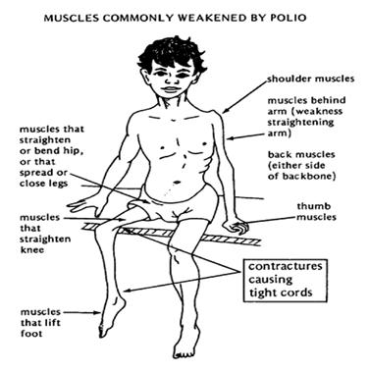
Muscles commonly affected by polio virus ...

Slide 6
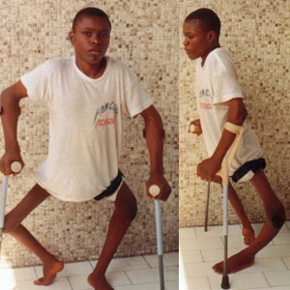
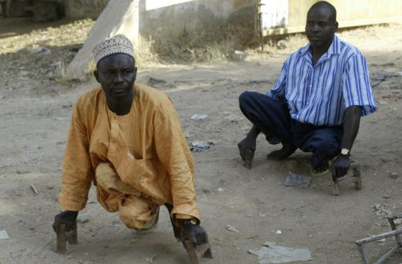
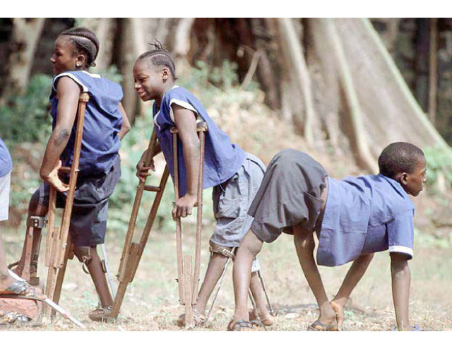
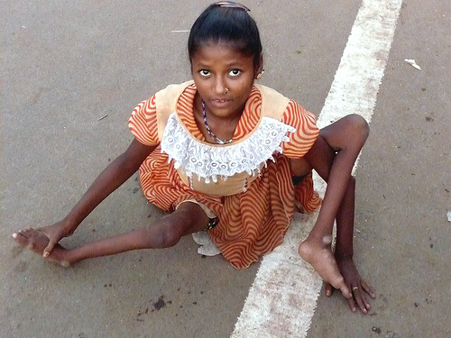

Slide 7
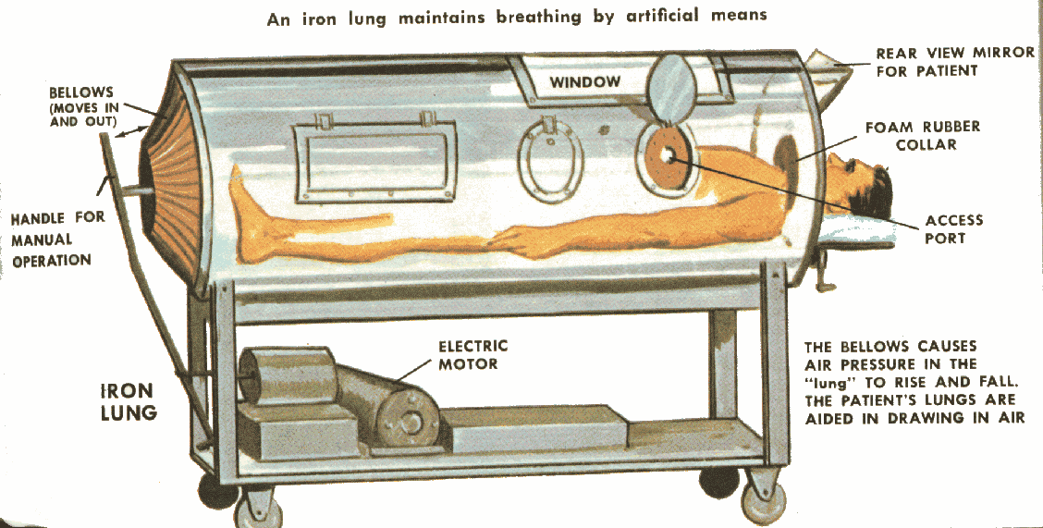
When muscles in the chest were affected, an iron lung could maintain breathing by artificial means

Slide 8
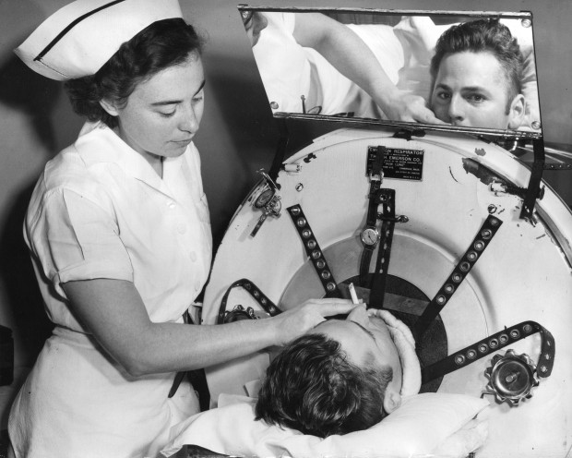
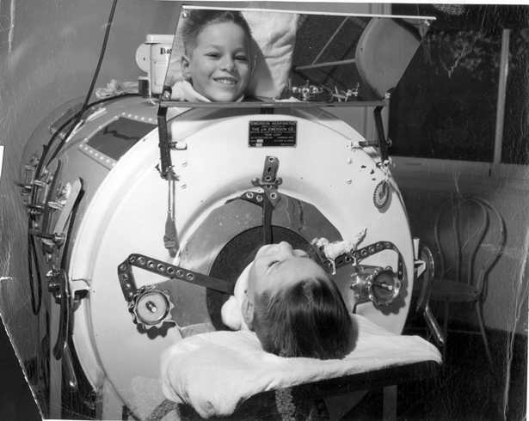
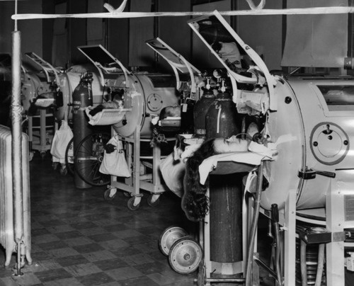
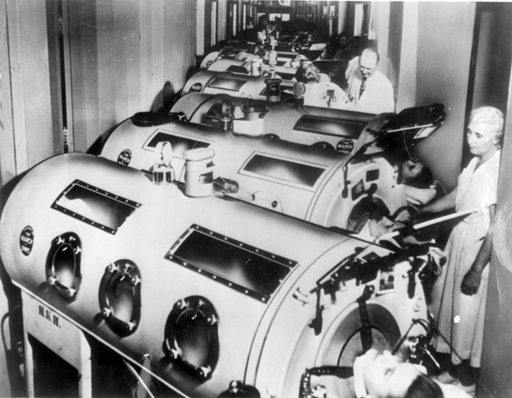

Slide 9
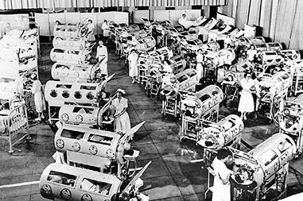
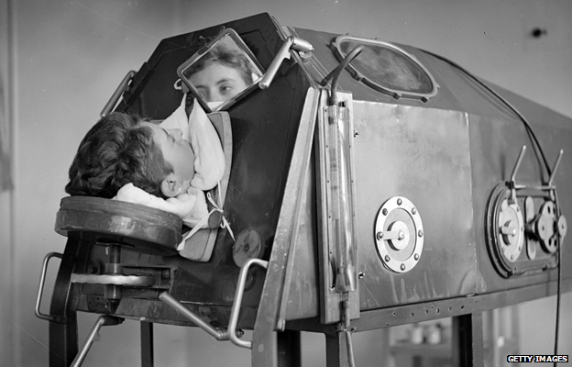

Slide 10
Treatment & Prevention
No cure, only treatment to relieve symptoms
Heat & physical therapy to stimulate muscles ...
...& antispasmodic drugs to relax muscles
Can be prevented - vaccines given multiple times protects a child for life

Slide 11
The Vaccines
One of the major break-throughs of the 20th C.
Five different vaccines available
Oral polio vaccine (OPV)
Two monovalent oral polio vaccines (mOPV1 and mOPV3)
Bivalent oral polio vaccine (bOPV)
Inactivated polio vaccine (IPV) - injected - every country to use this at least once for each child by the end of 2015
If enough people are immunized, the virus will die out.

Slide 12
How did the campaign begin?
1979 - RIP (Australian) Clem Renouf given some polio vaccine
Chose to immunize all children in the Philippines - 6 million
1982 - decided to immunise all the children of the world to eradicate polio by centenary of Rotary in 2005.

Slide 13
What was needed?
Dr Albert Sabin recommended they would need $100 million
Set about raising $120 million
Donated or raised $247 million
1986 - went to WHO with the proposal AND the money
Partners with UNICEF & US CDC (Center for Disease Control)

Slide 14
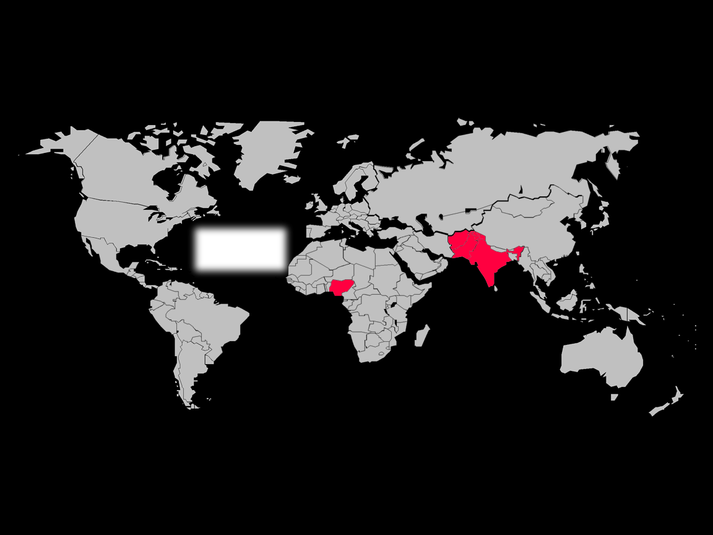
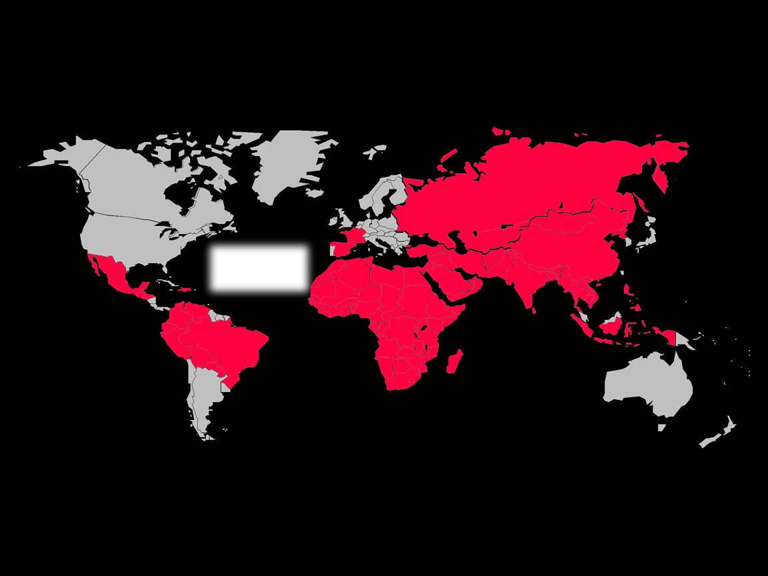
Progress in Polio Eradication

Slide 15
How has this been achieved?
NID’s - National Immunisations Days when millions of children will be vaccinated over 1 or 2 days
Mass mobilisation of volunteers & government agencies & workers
Transport, chilling of vaccine
Organisation ...organisation .. organisation!!!

Slide 16
What have been major problems?
Lack of hygienic living conditions
Poor nutrition
Vaccine derived cases - change of vaccines
Resistance based on religious or cultural differences
Difficulties in access to some areas
Conflicts between countries / groups
Movement of people across borders

Slide 17
Progress has NOT been steady!
1,997
Non Endemic
Pakistan
Afghanistan
India
790
Nigeria
2006
2007
*As of 4 December 2007

Slide 18
Progress has NOT been steady!
In 2012, there were 223 polio cases in five countries.
In 2013, there were 407 cases in eight countries
Spread from Pakistan to Syria, Israel, Gaza, Iraq.
From Nigeria to Cameroons Equ. Guinea

Slide 19
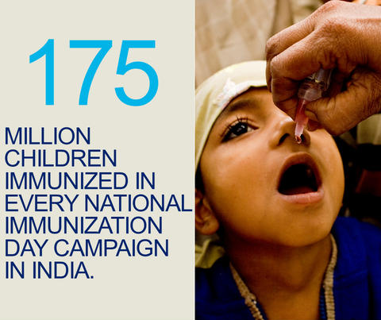
Where are we in 2015?
India a great success!

Slide 20
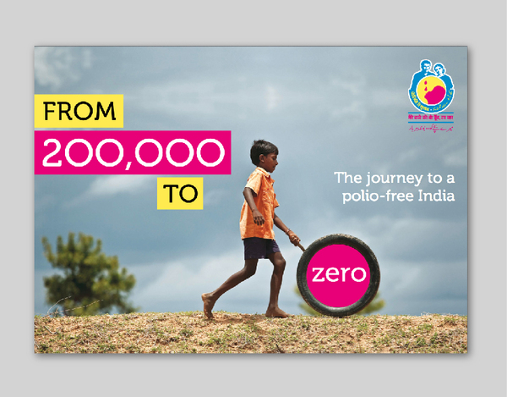

Slide 21
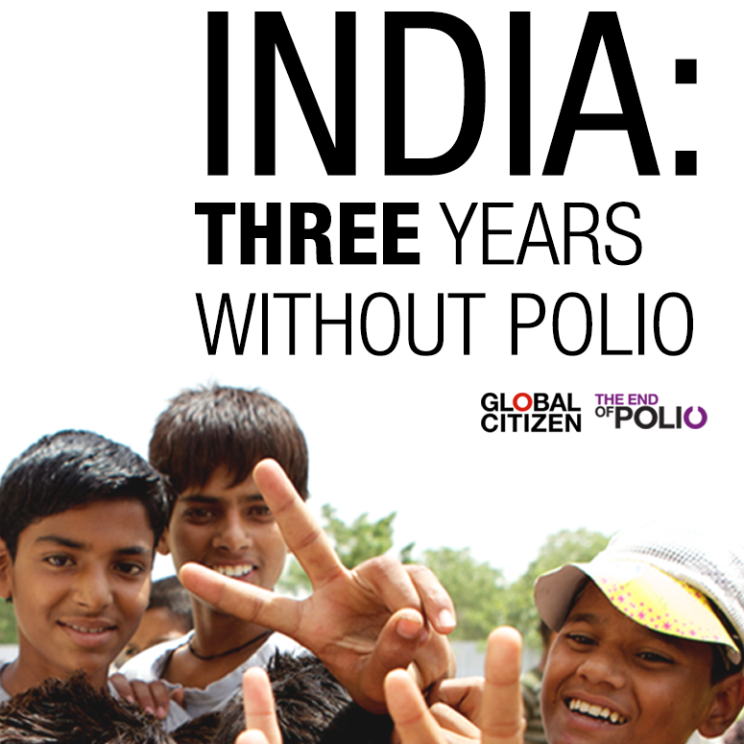
13 January 2014

Slide 22
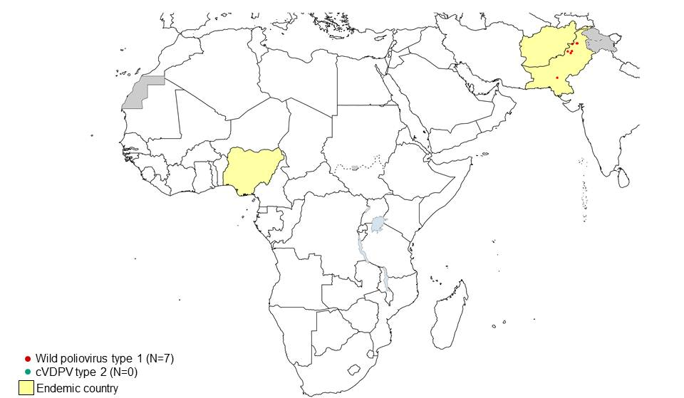
Where are we in 2015?
Afghanistan 2014 - 28
2015 - 13 cases to date
Nigeria 2014 - 36
2015 - no cases since July last year
Tentatively declared polio free Sept 2015

Slide 23
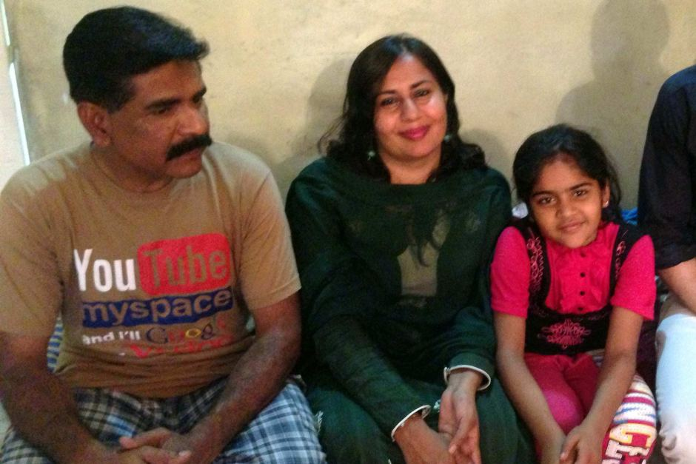
Where are we today in 2015?
Pakistan - 2014 - 328
Health workers murdered
Eg Naseem Munir
2015 - 38 cases to date
Big effort underway: 35 million chn vaccinated in Sept 2015

Slide 24
Cost (main contributors)
Rotary - $1.4 billion
Bill & Melinda Gates - $1 billion +
US Govt - $1.9 billion
UK Govt - $1 billion
Indian Govt - $1.6 billion
Japanese govt - $0.5 billion

Slide 25
What next?
Through 2018 every $1 Rotary commits to direct support for polio immunization will be matched 2-to-1 (up to $35 million per year) by the Bill & Melinda Gates Foundation.
Each donation to PolioPlus makes triple the impact!

Slide 26
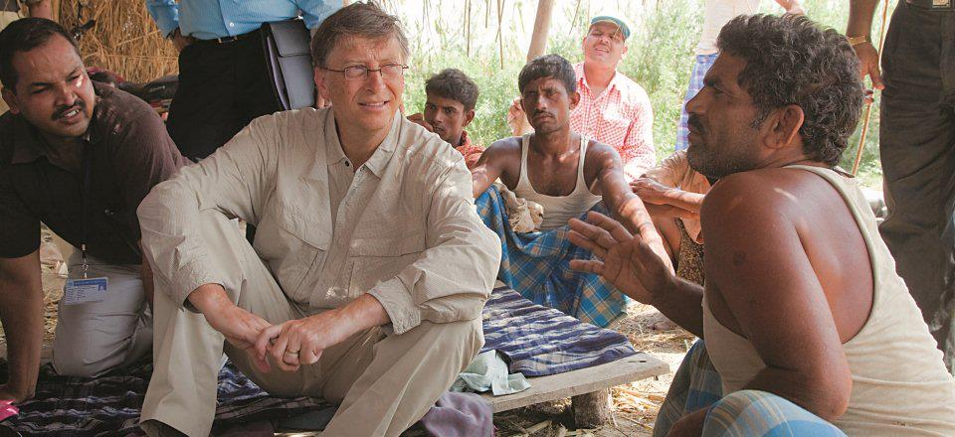
Mr Gates acknowledges that the final push against polio is proving extremely difficult: "I can say without reservation that the last mile is not only the hardest mile, it's also much harder than I expected”.

Slide 27
But we have come a long way:
4000 years ago - disease recorded
200 years ago - we realised it was contagious
100 years ago - it was a virus
60 years ago - a vaccine could prevent it
30 years ago - it was decided that we should try to eradicate it from the world

Slide 28
But note:
About 40% of those who survive paralytic polio will develop further symptoms 15-40 years after the original illness
Called post-polio syndrome
Progressive muscle weakness
Severe fatigue, muscle & joint pain
...... A challenge for the future!

Slide 29
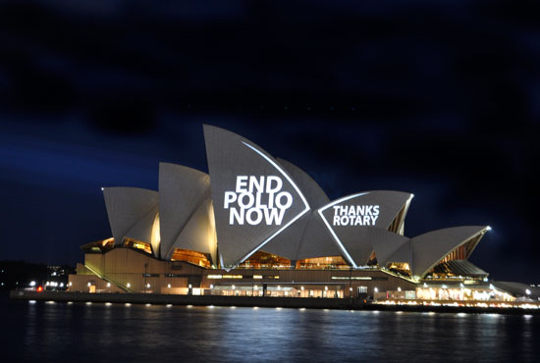
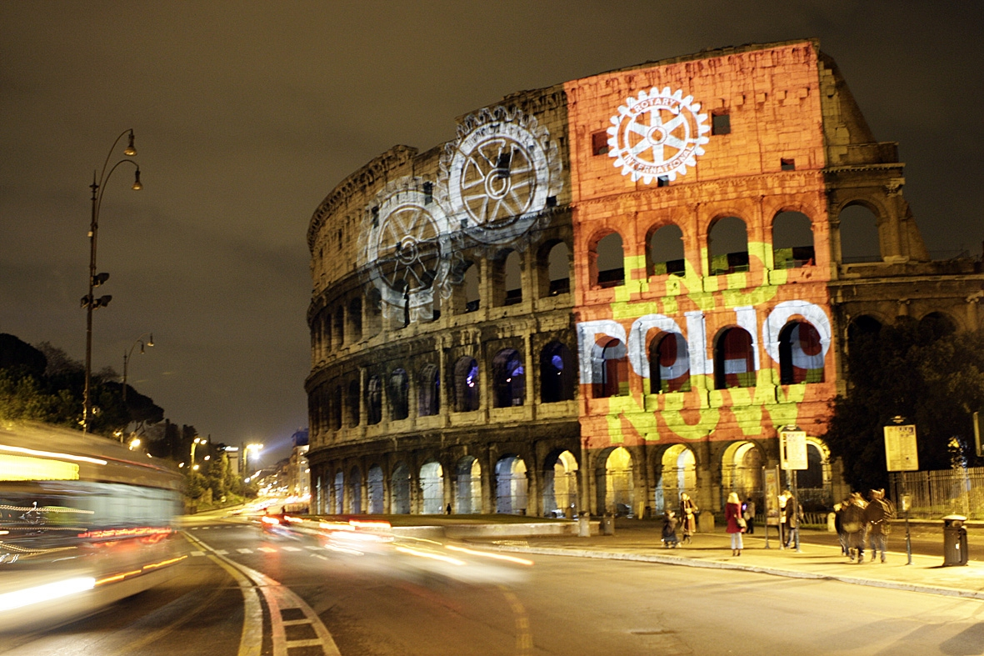
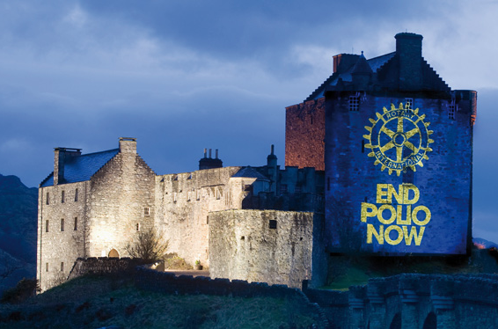
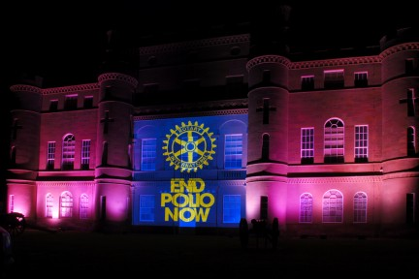
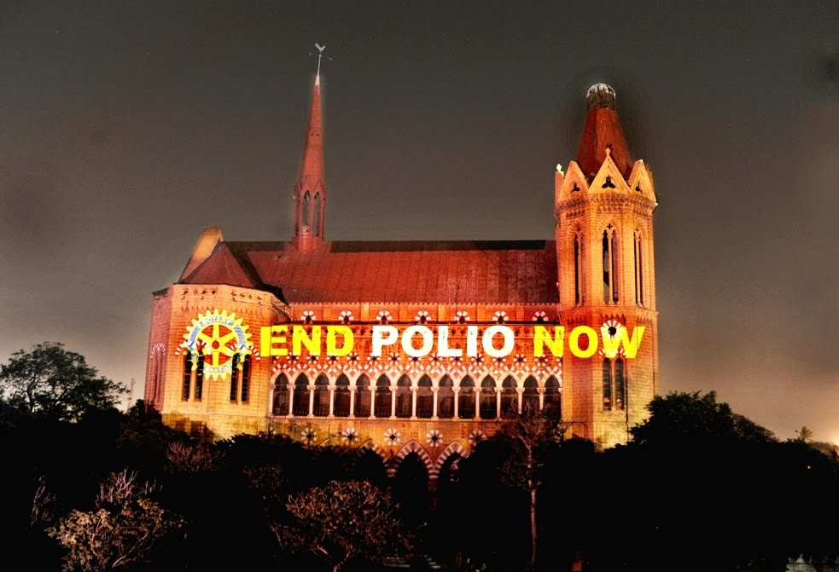

Slide 30
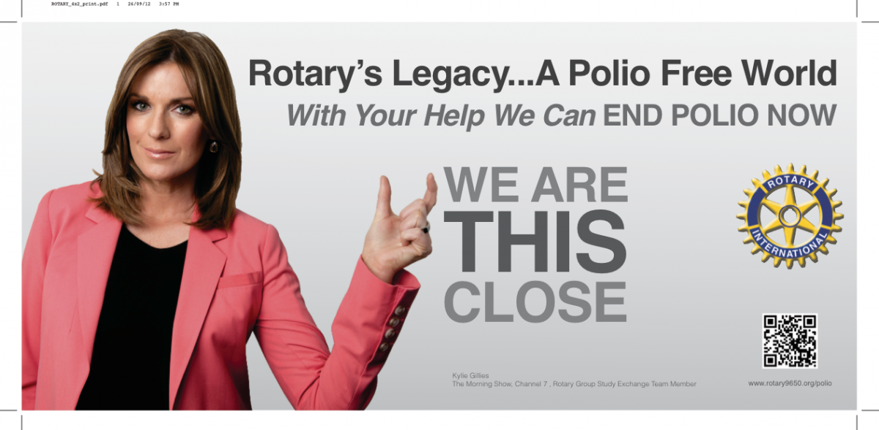
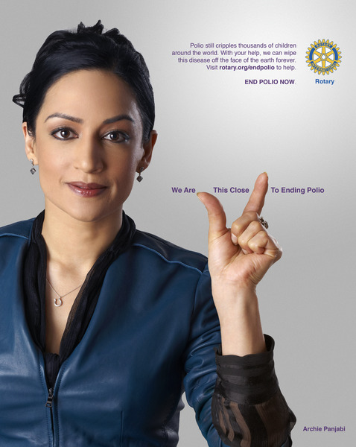
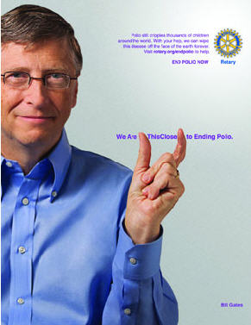
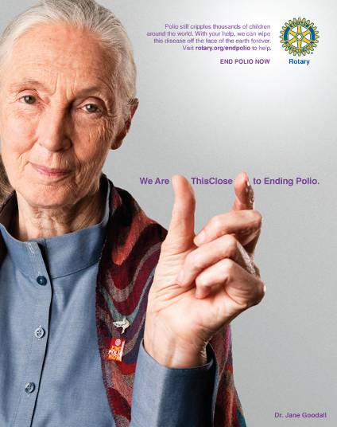
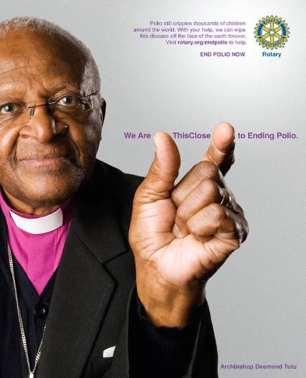

Slide 31


Slide 32
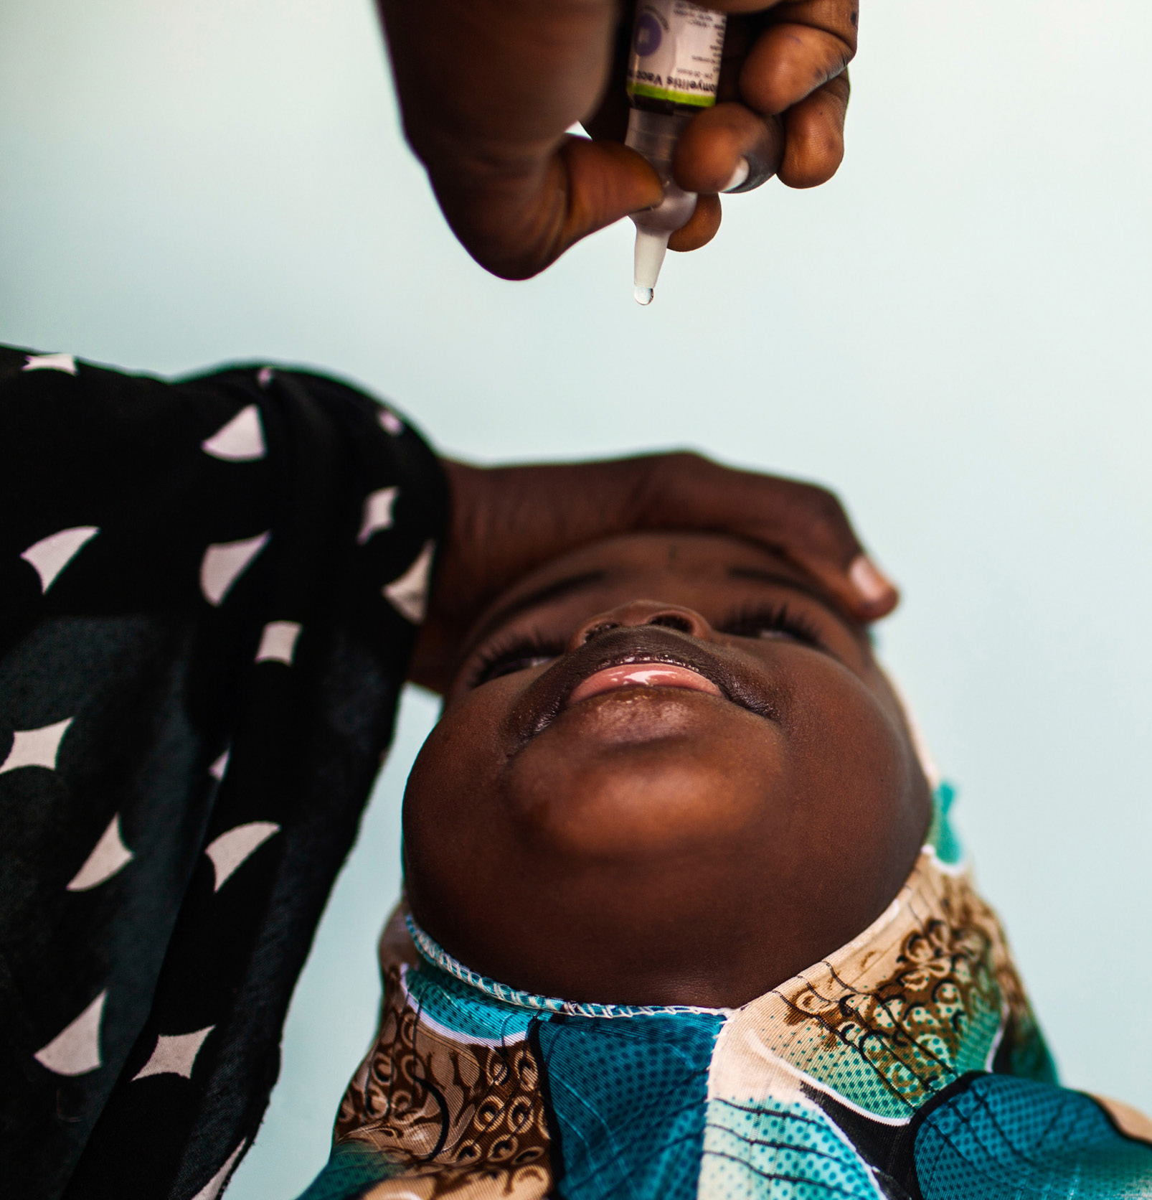

Slide 33
