Slide 1

Rotary Foundation Update
‘Doing good in the world’
‘Shaping the Future’
PDG Jo Wilkin Foundation Chair D9650 2015-18
District Conference 10 March 2018

Slide 2

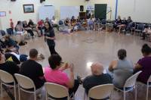
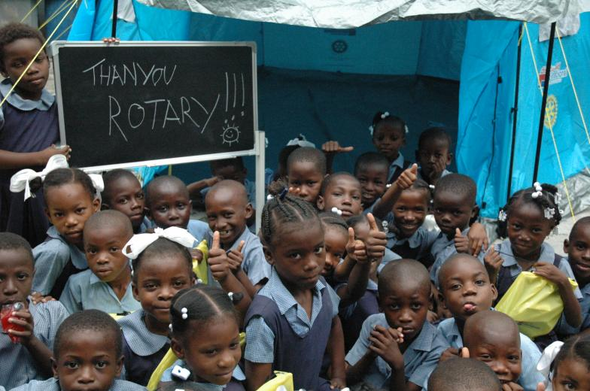
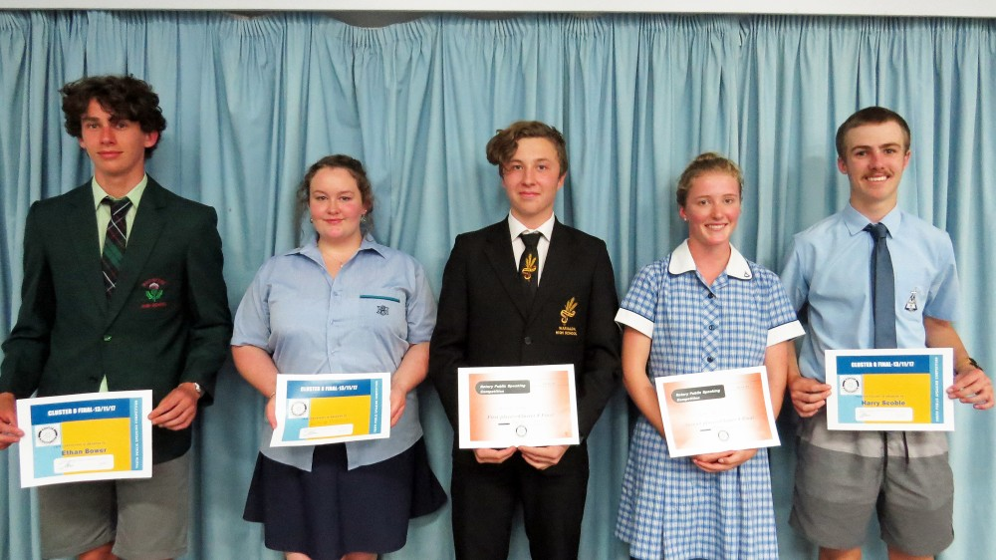
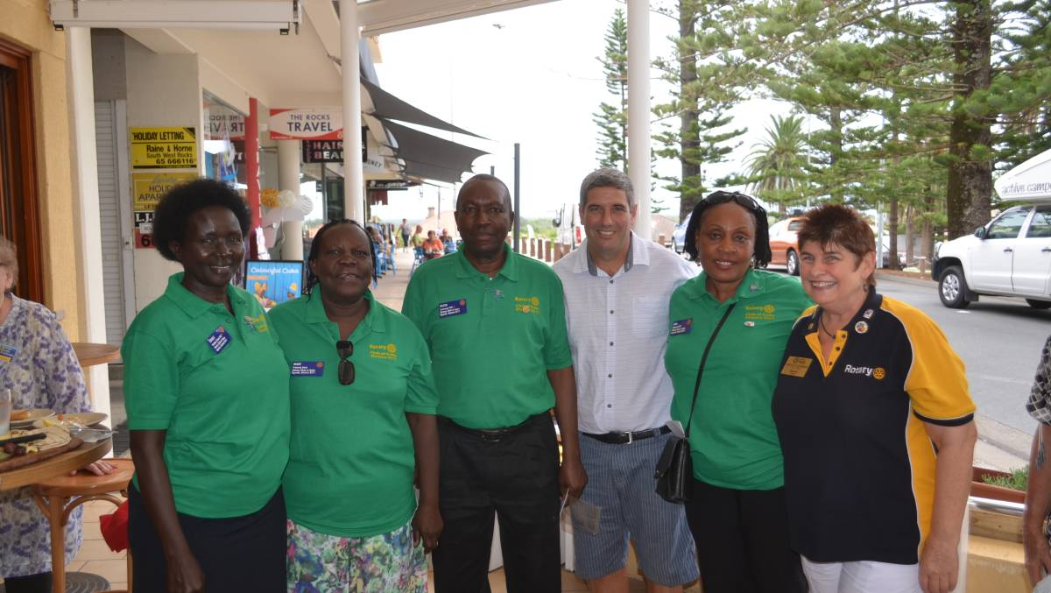
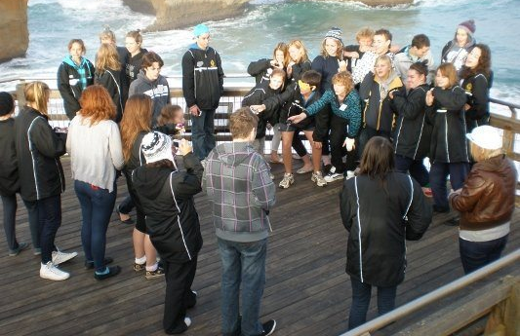
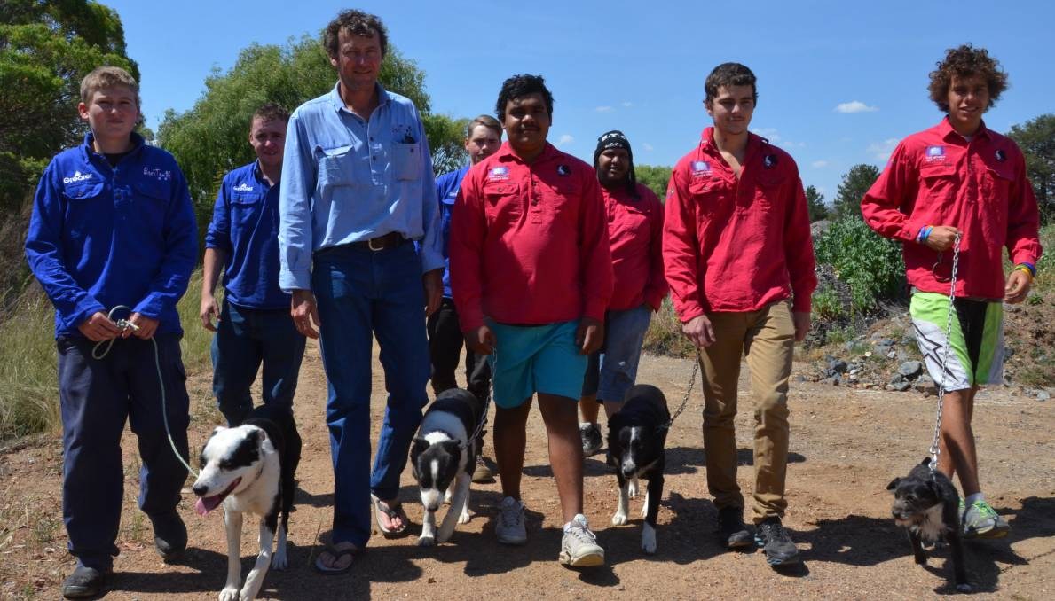
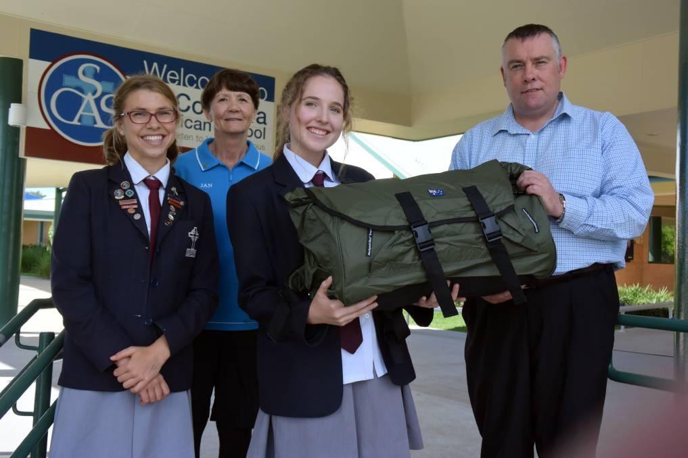
Session 3: Opportunities for Youth
How is
the Rotary Foundation
‘Shaping the Future’
by
helping Youth?
Terrorism
Youth Insearch
Disaster Aid
Public Speaking
Group Study Exchange
Backtrack
Interact
RANZSE

Slide 3
Four Major Funds in the Foundation
PolioPlus Fund

Slide 4
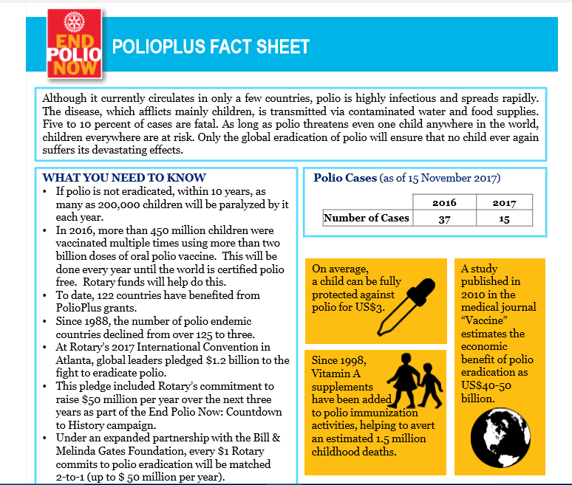
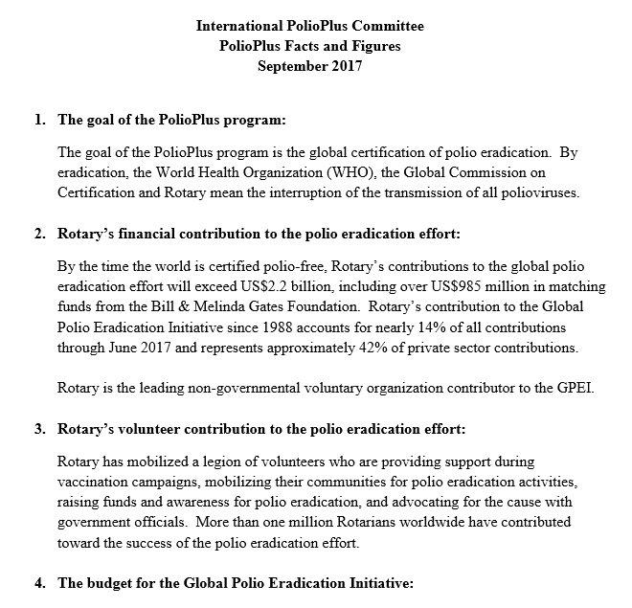
Polio Campaign Update
PolioPlus Fund
Rotary’s #1 Goal

Slide 5
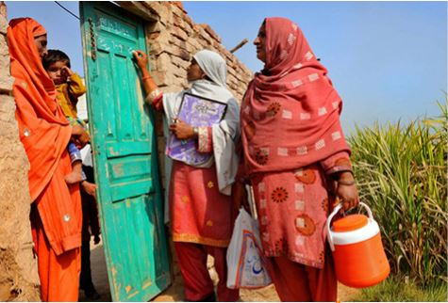
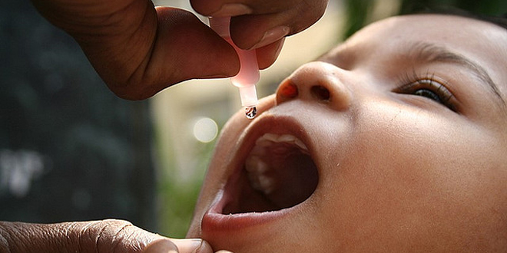
Polio Campaign Update
1985 - 350,000
2014 - 392
2017 - 22

Slide 6
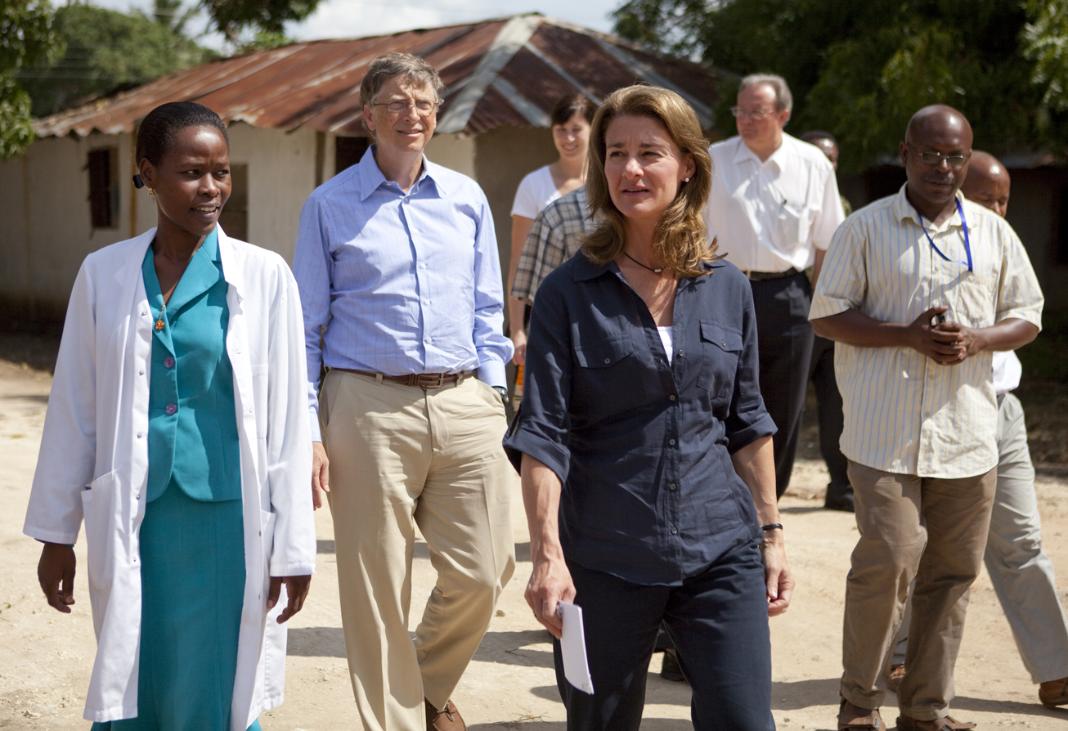
We need to finish the task
Raise $50 million each year for 3 years
Bill & Melinda Gates
Foundation will match it two to one
Totals $450 million
by 2020.

Slide 7
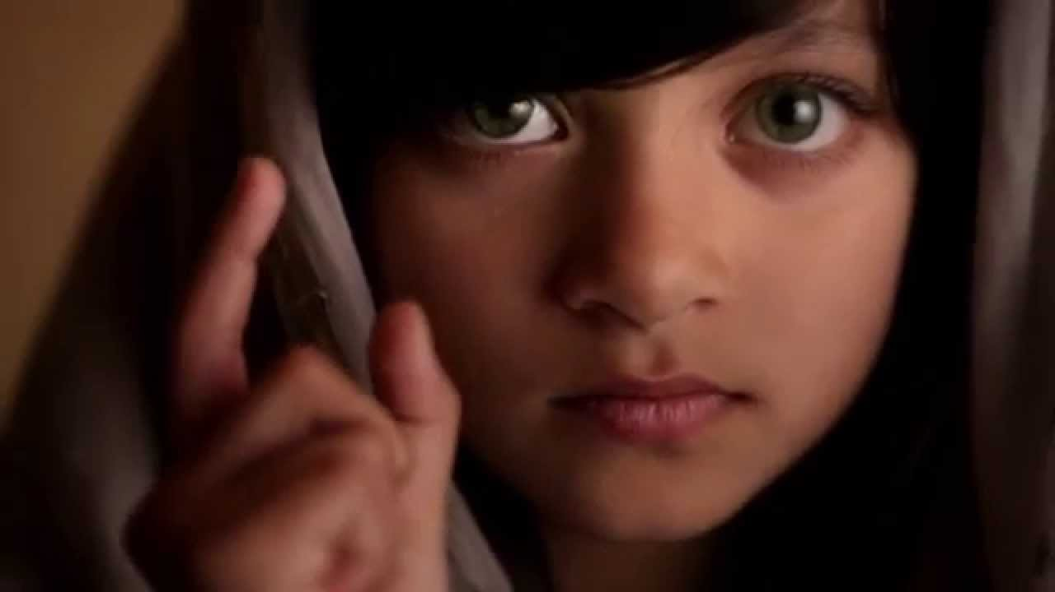
We are this close ….

Slide 8
Four Major Funds in the Foundation
Endowment Fund

Slide 9
Four Major Funds in the Foundation
Endowment Fund
Ensures permanent future

Slide 10
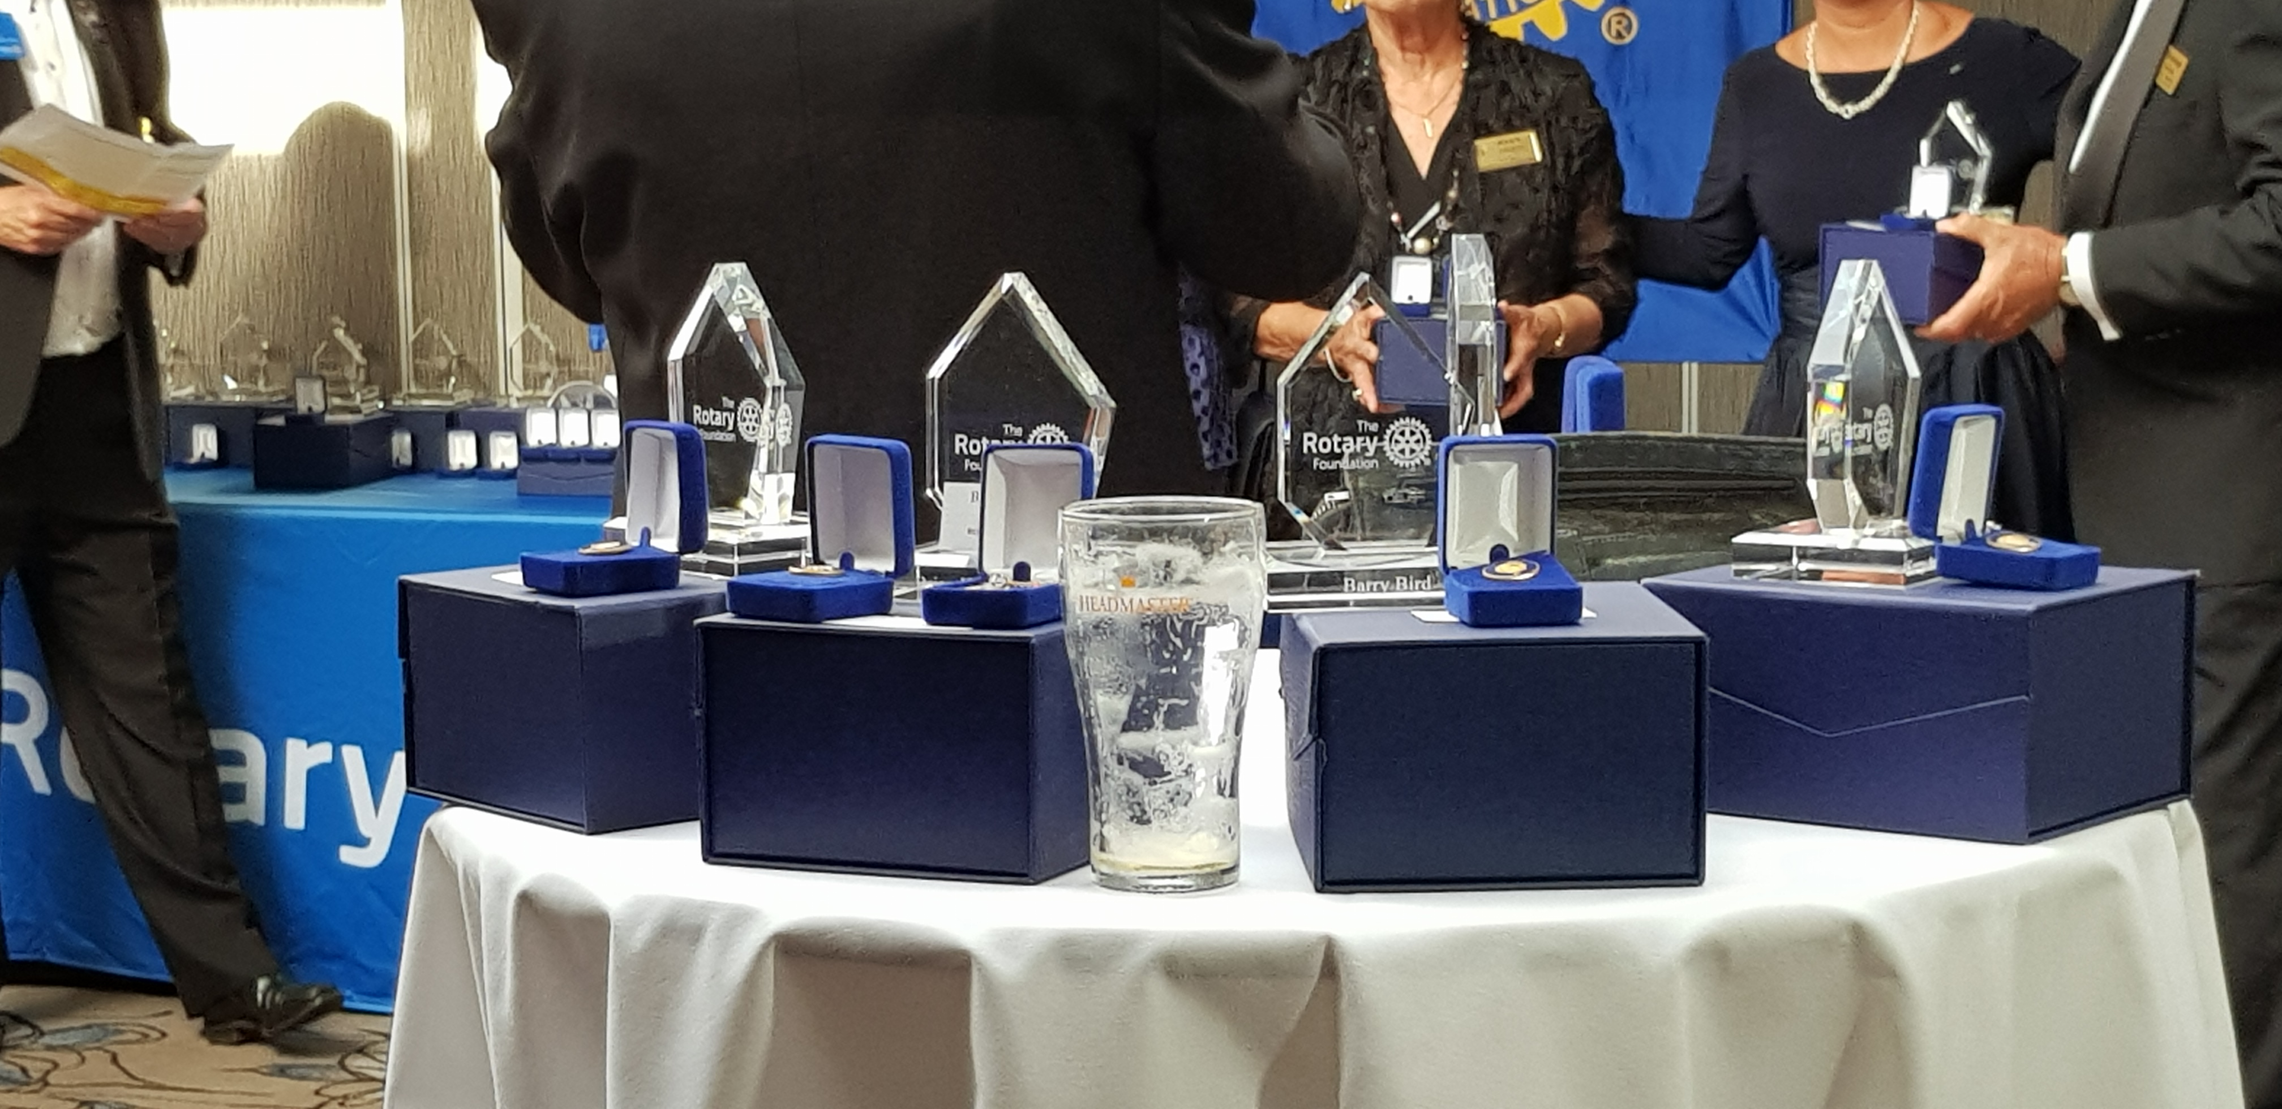
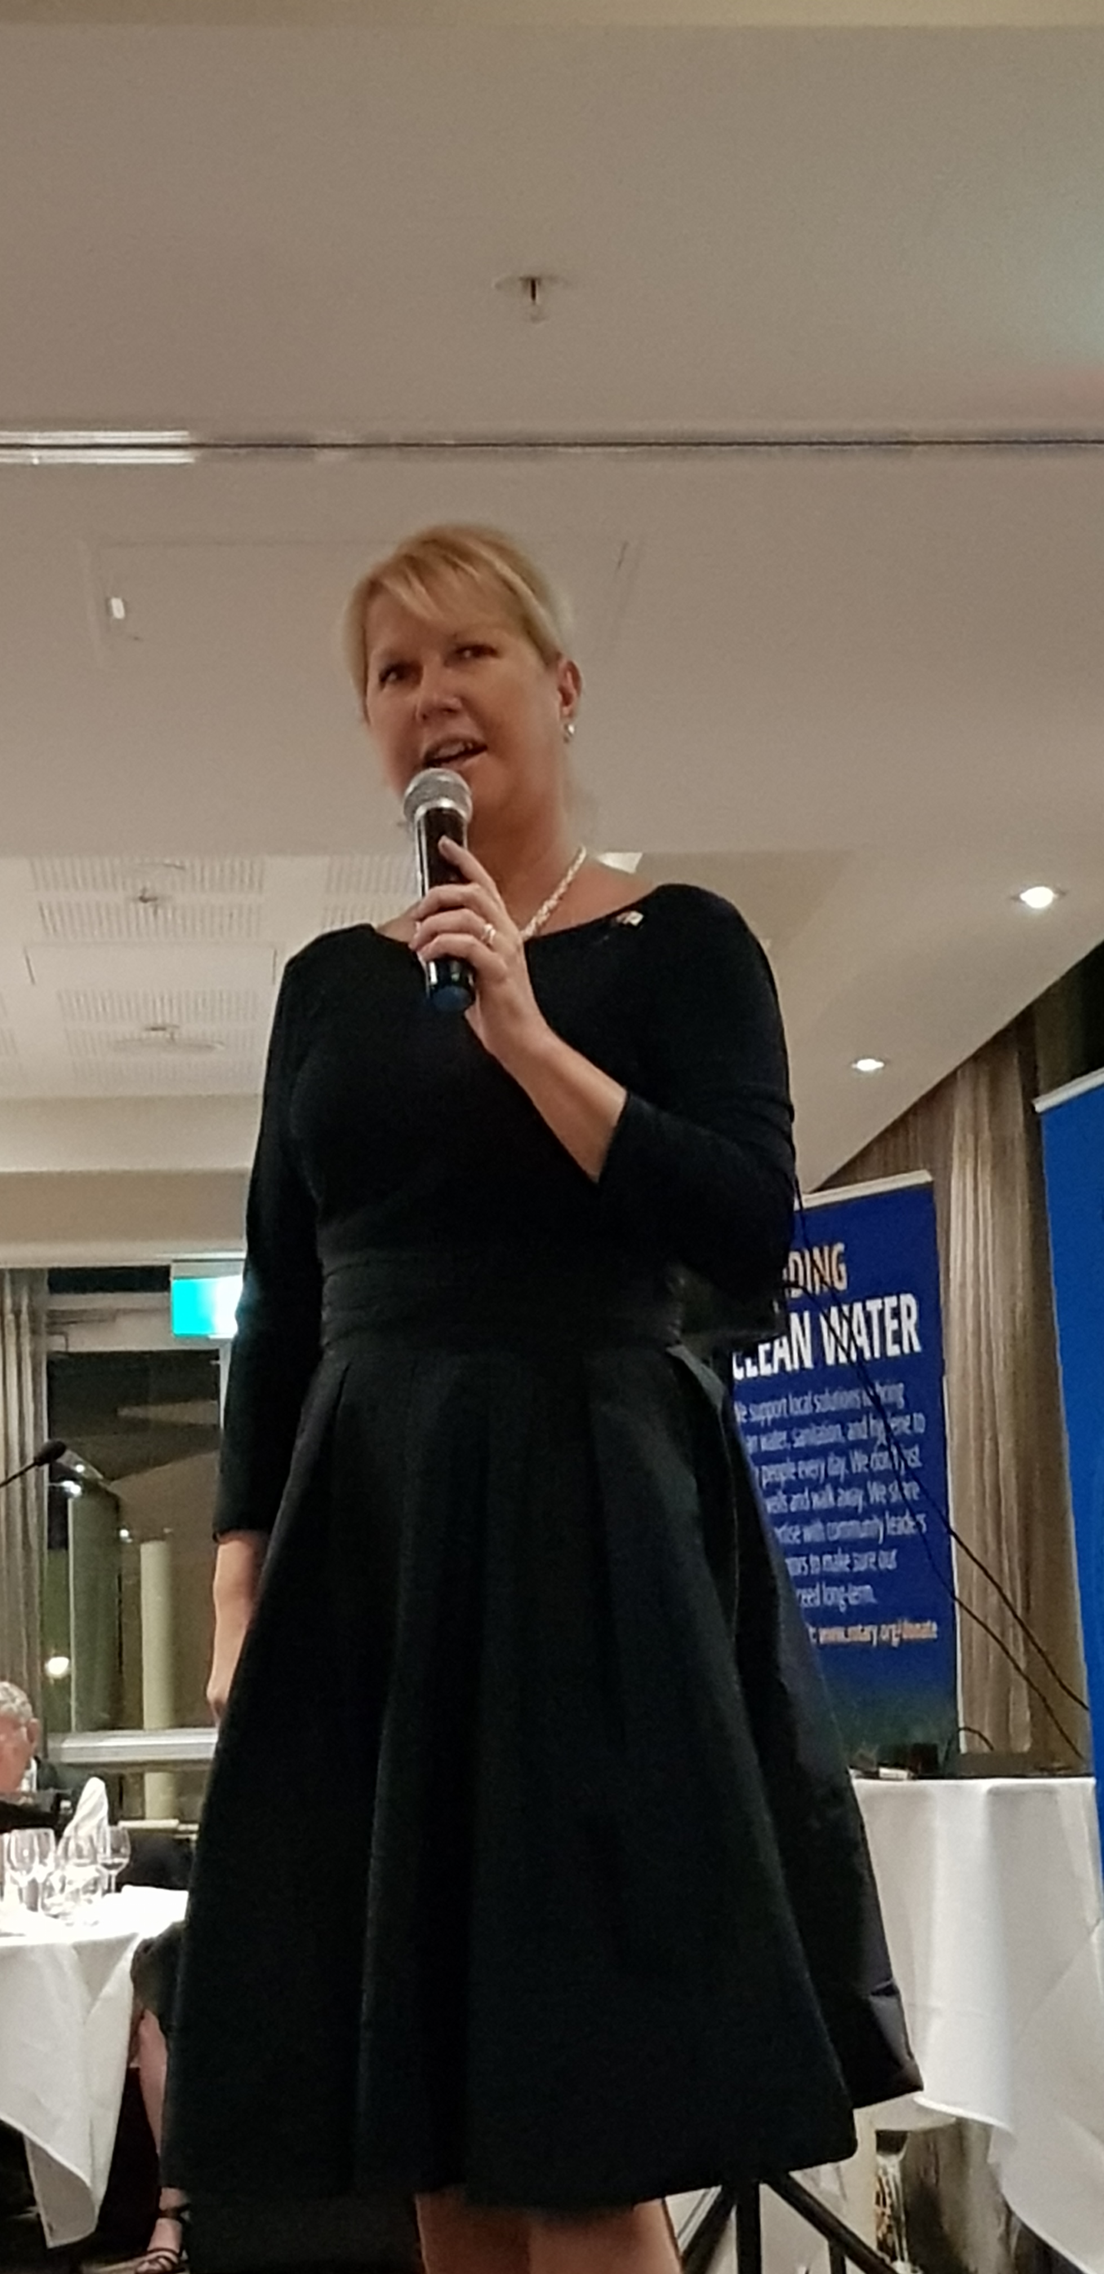
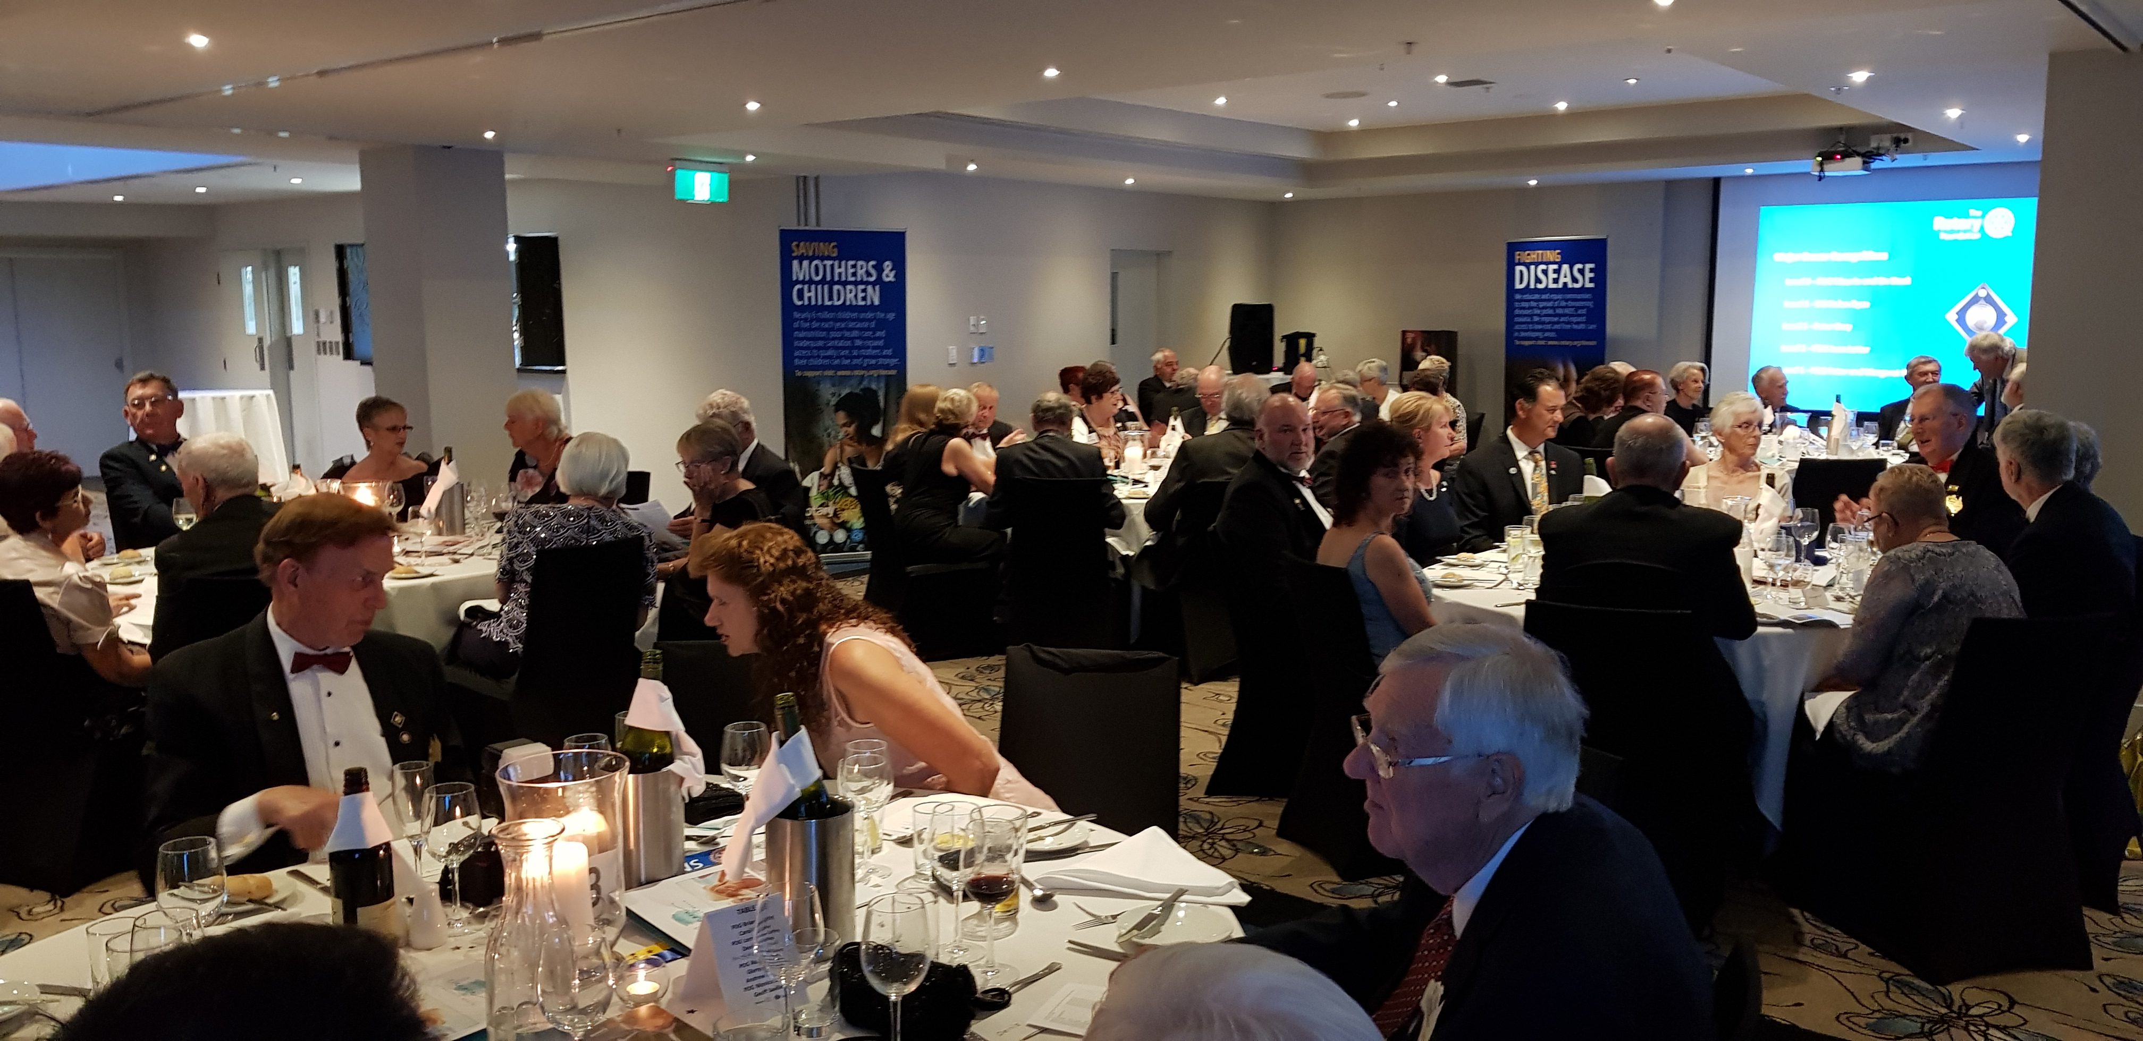
Endowment Fund Update
Million Dollar Dinner celebration for the Centenary
Endowment Fund
Ensures permanent future
$1.2 million from
D9650 & D9670

Slide 11

Handing on to the next generation ….

Slide 12
Four Major Funds in the Foundation
PolioPlus Fund
Rotary’s #1 Goal

Slide 13
Four Major Funds in the Foundation
PolioPlus Fund
Rotary’s #1 Goal
Endowment Fund
Ensures permanent future

Slide 14
Four Major Funds in the Foundation
PolioPlus Fund | Annual Programs Fund | World Fund | Endowment Fund
Rotary’s #1 Goal |  |  | Ensures Permanent future

Slide 15
Four Major Funds in the Foundation
PolioPlus Fund | Annual Programs Fund | World Fund | Endowment Fund
Rotary’s #1 Goal |  |  | Ensures Permanent future
‘SHARE’
Provide grants to do all of Rotary’s other projects

Slide 16
Four Major Funds in the Foundation
Annual Programs Fund | World Fund
Contributions from clubs & members
District
&
Global
grants
District Designated Fund - DDF

Slide 17
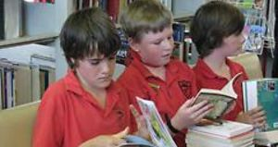
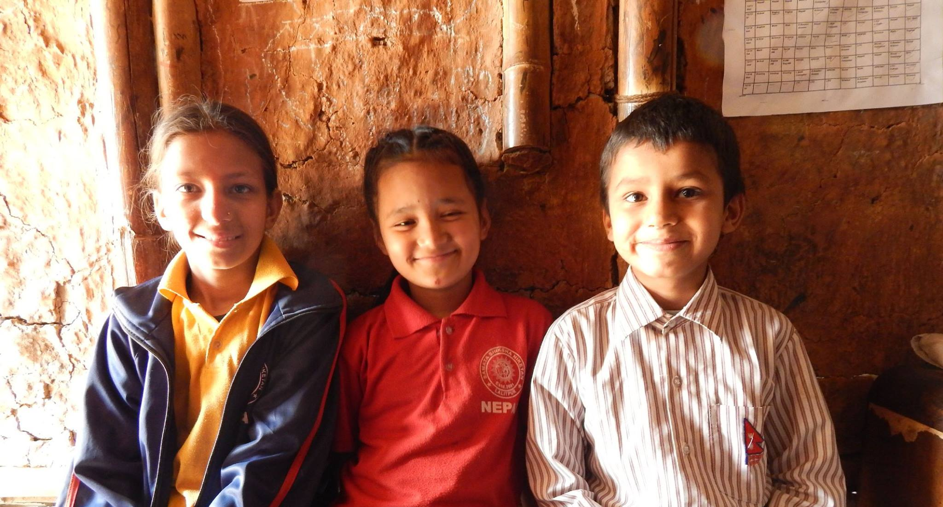
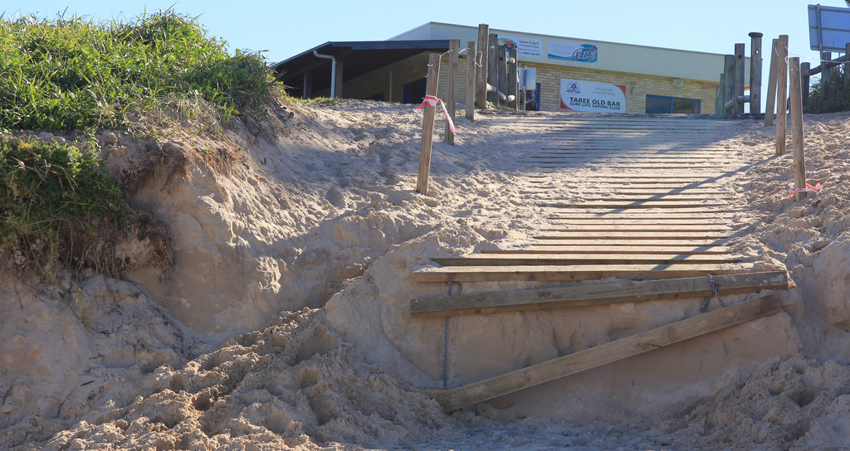
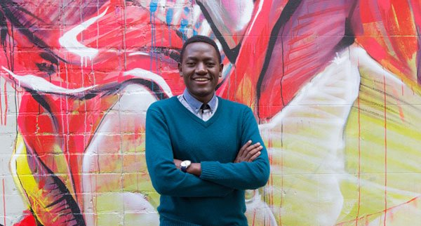
District Grants Update
2017-18 : AU$30,000 - 7 clubs
Laurieton
Uralla
Forster
Old Bar
Taree on
Manning

Slide 18
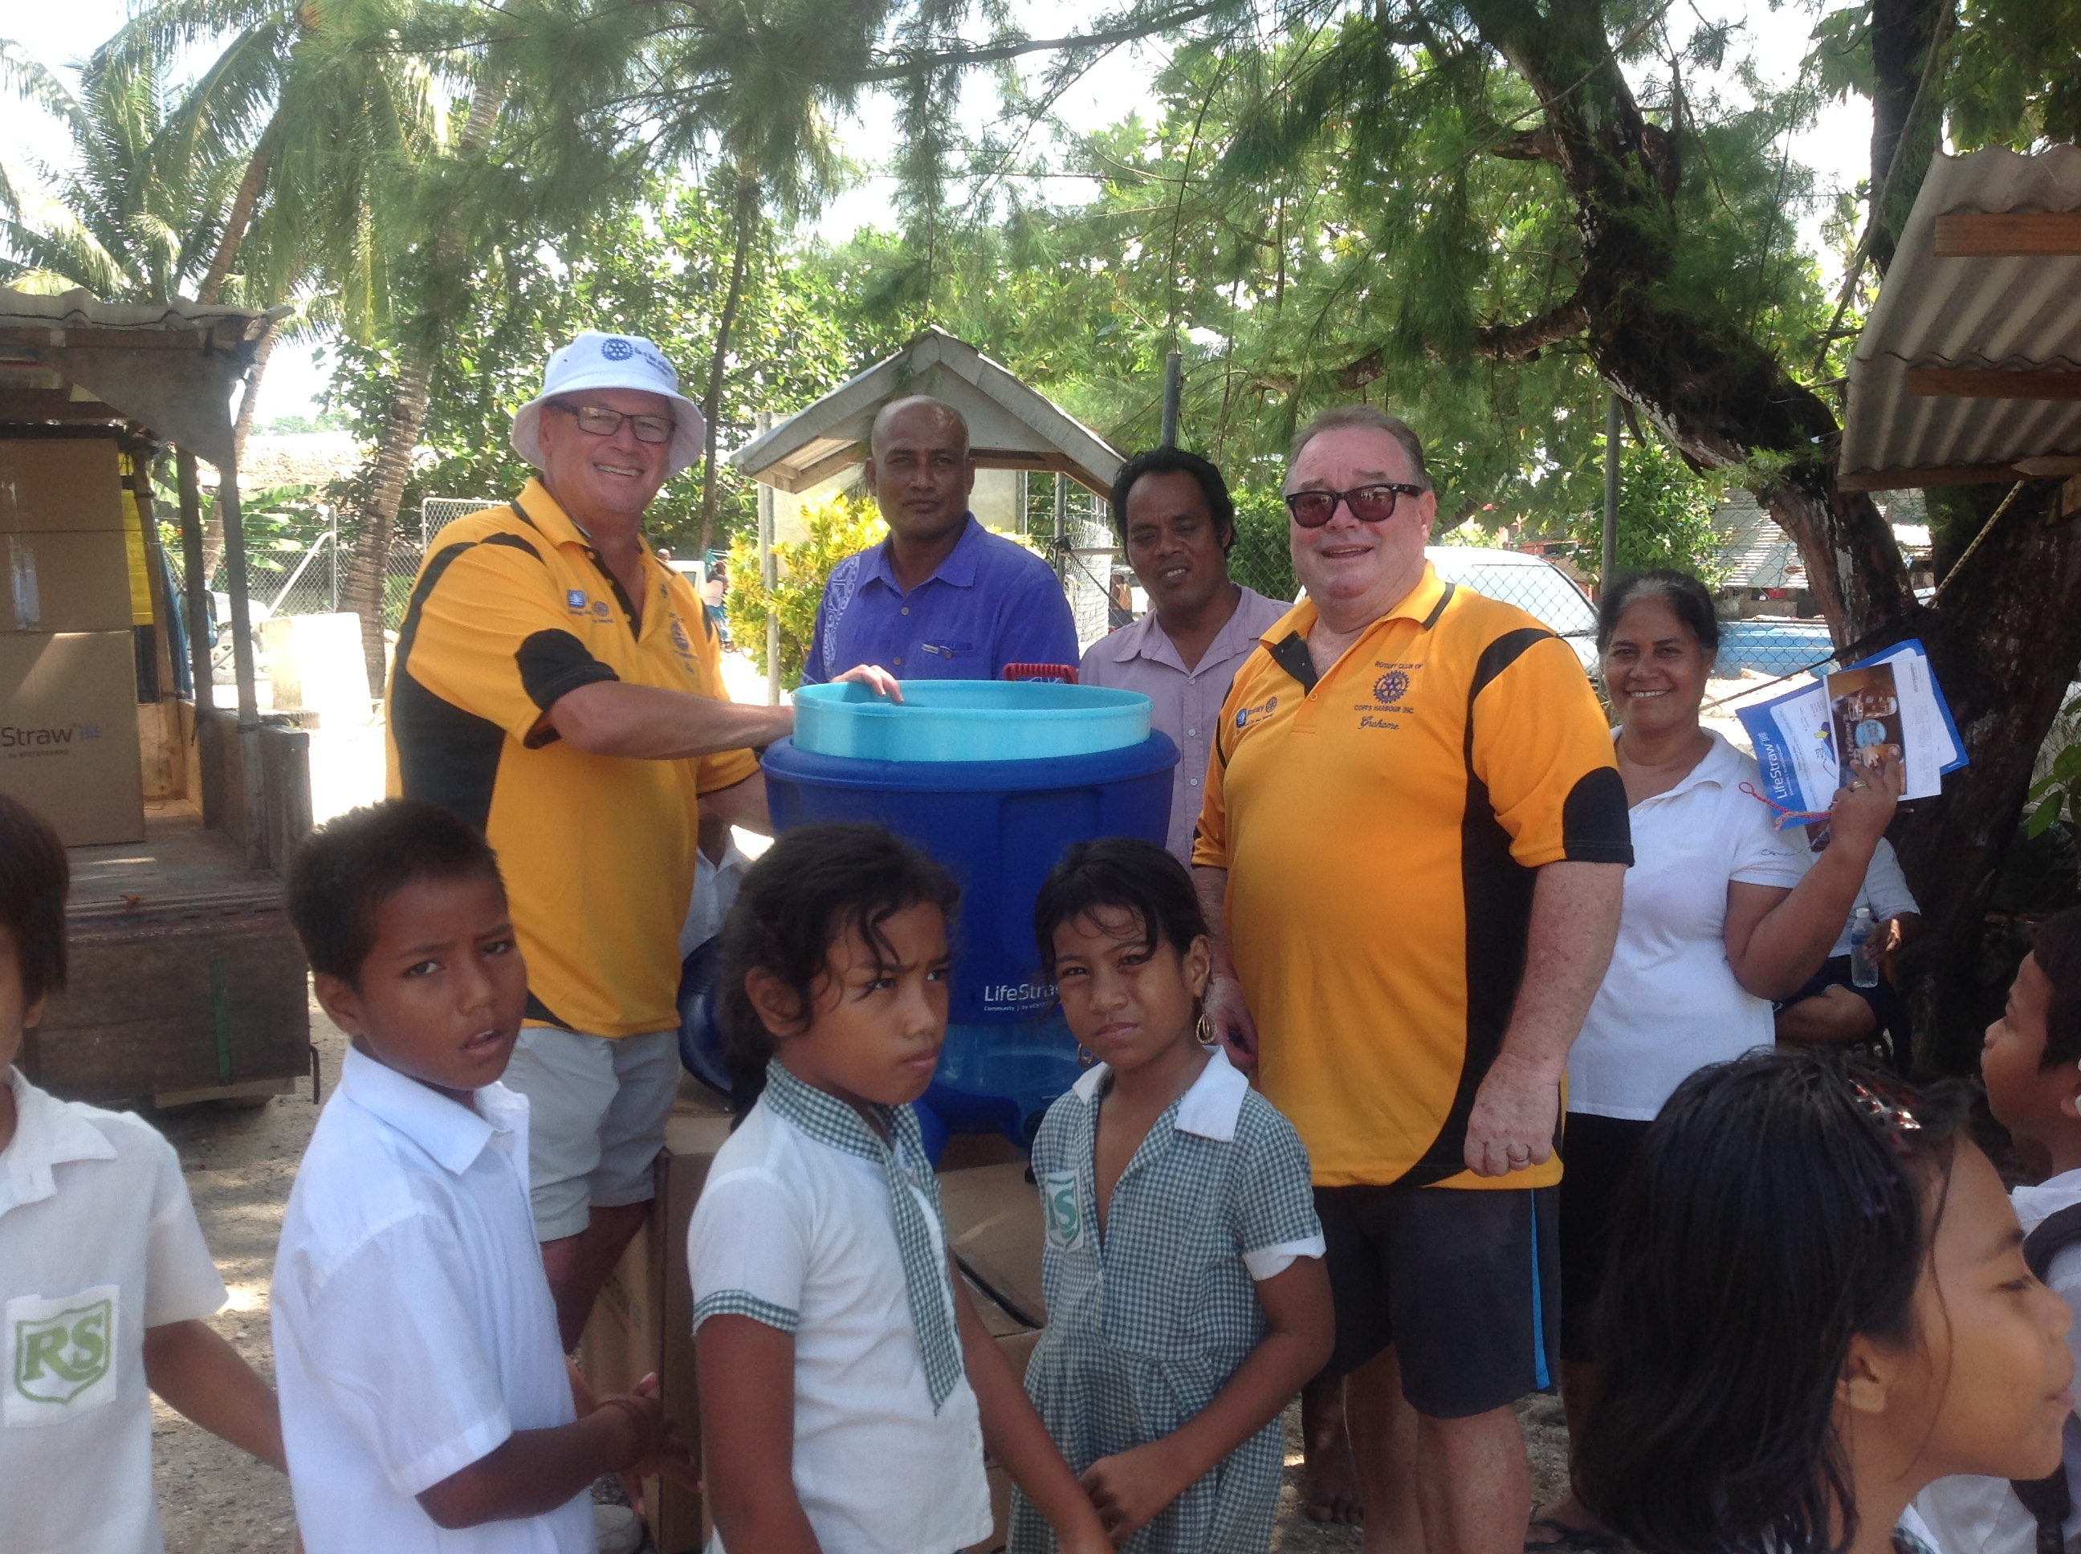
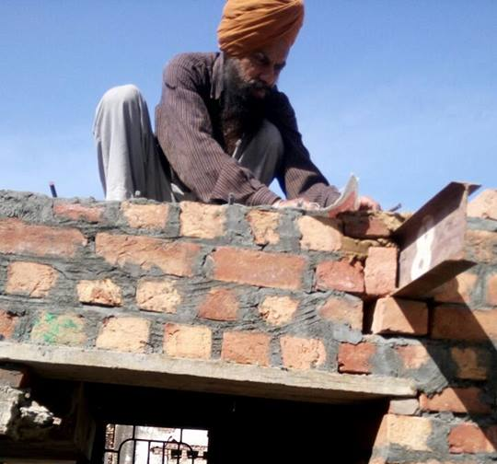
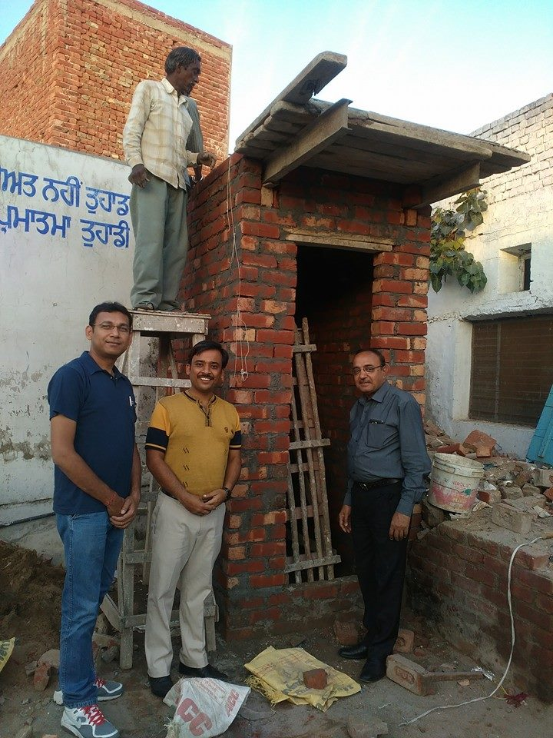
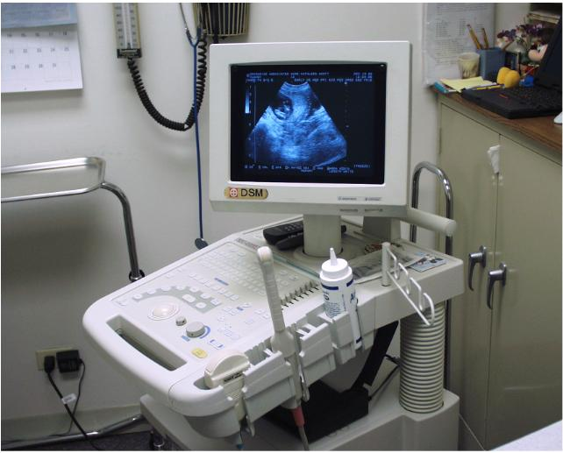
Global Grants Update
Projects >US$30,000
Tamworth
Coffs Harbour
Armidale AM

Slide 19
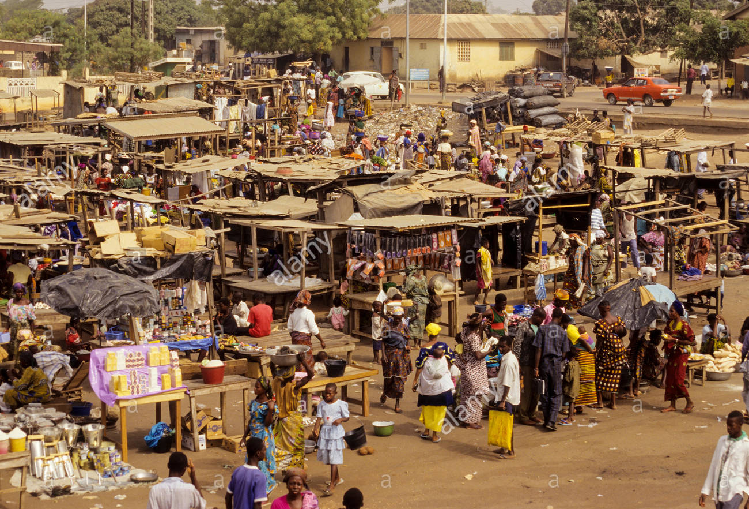
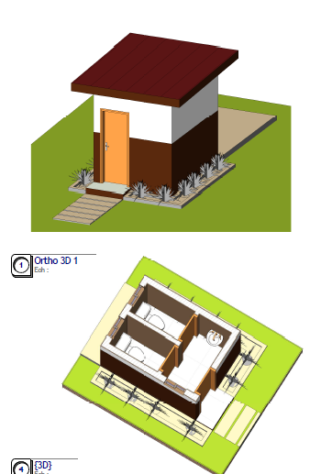
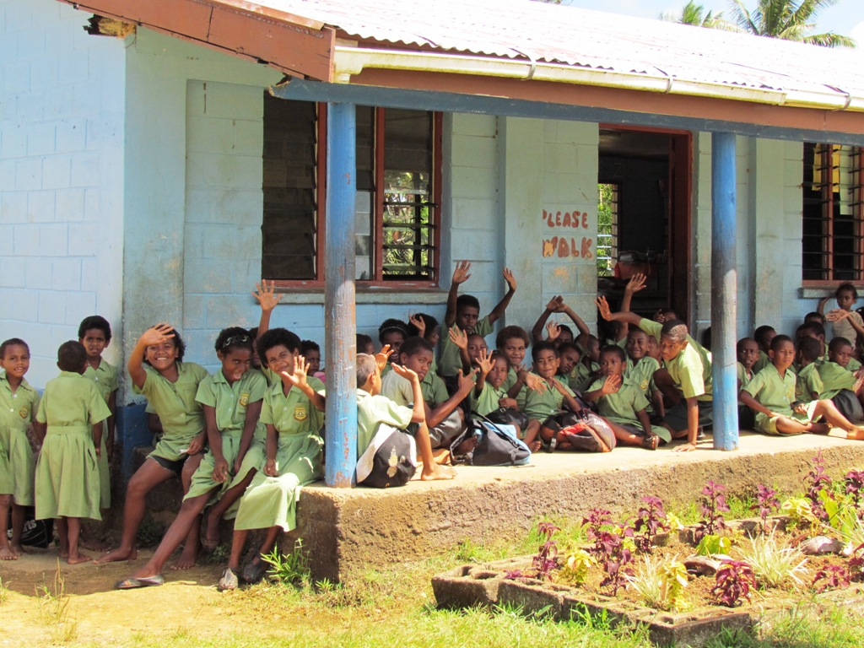
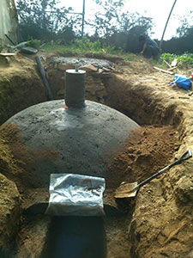
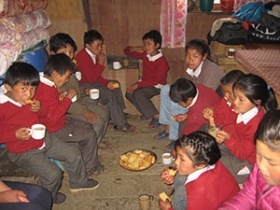
Global Grants Update
Projects >US$30,000
Taree on
Manning
Nambucca Heads
Port
Macquarie
Sunrise
Biogas digester

Slide 20
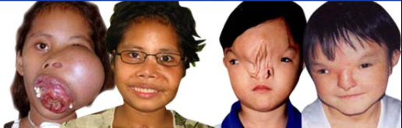
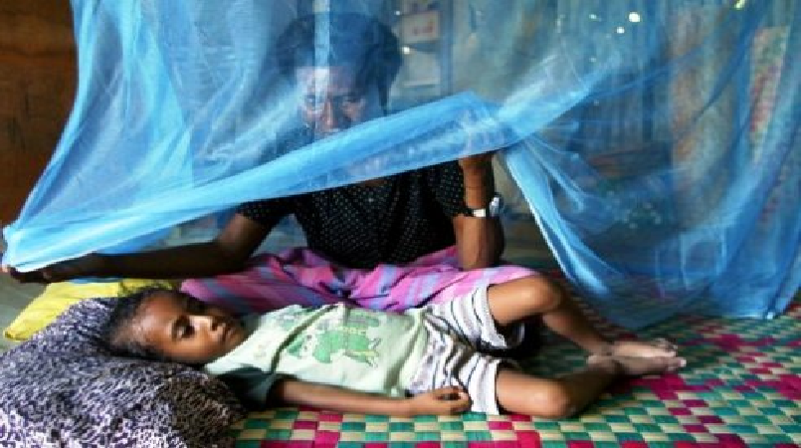
Global Grants Update
Projects >US$30,000
ROMAC - Rotary Oceania Medical Aid for Children
RAM - Rotarians Against Malaria in Timor Leste

Slide 21
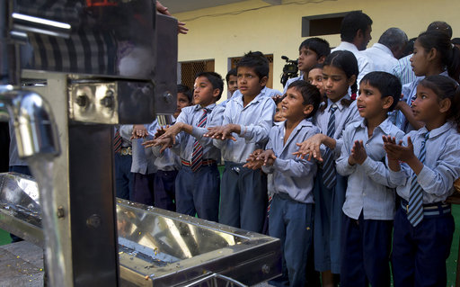
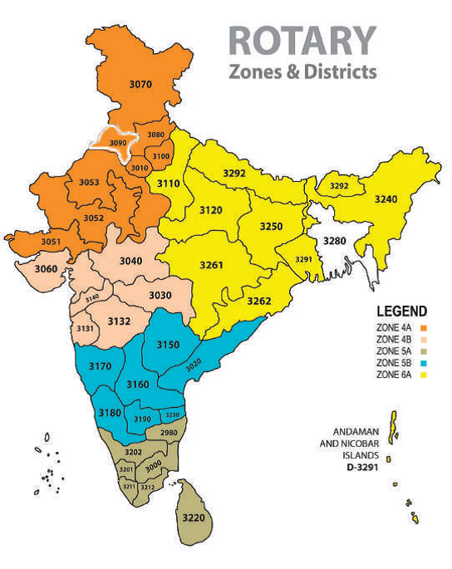
D9650 Centenary Global Grant Project
AU$27,000 - AU$120,000
PROGRESS TO DATE:
40 UNITS INSTALLED BY END OF DECEMBER
AIM TO BE FINISHED BY END OF APRIL
Clean drinking water in 80 schools in
D3090 in India

Slide 22
Maximising the Impact
Using the Foundation’s ‘Multiplier Effect’
WORLD FUND
Taree North - $2,500
Our District DDF - $4,500
3 other clubs + 3 other Districts
Budget - $47,000
Agra Rotary School, Shamshabad, India -
solar lighting, toilet blocks, “water stations”, a small bus for girls.

Slide 23
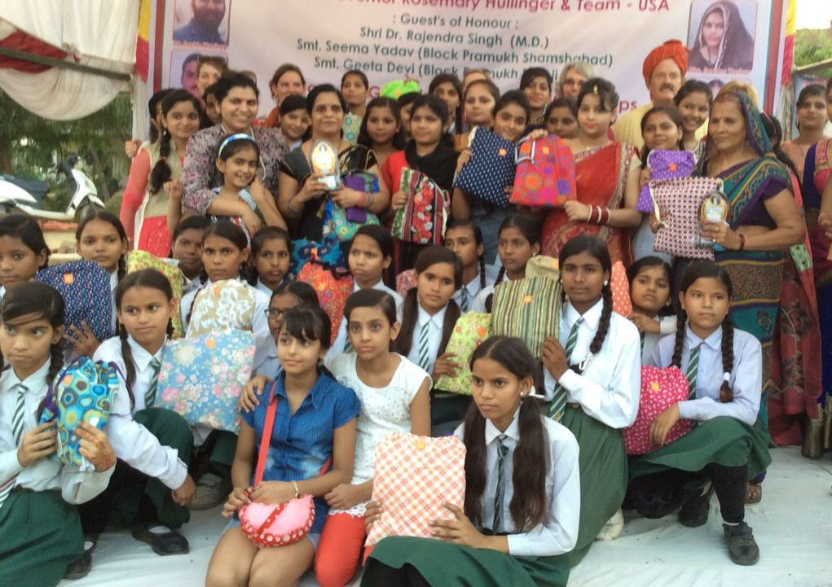
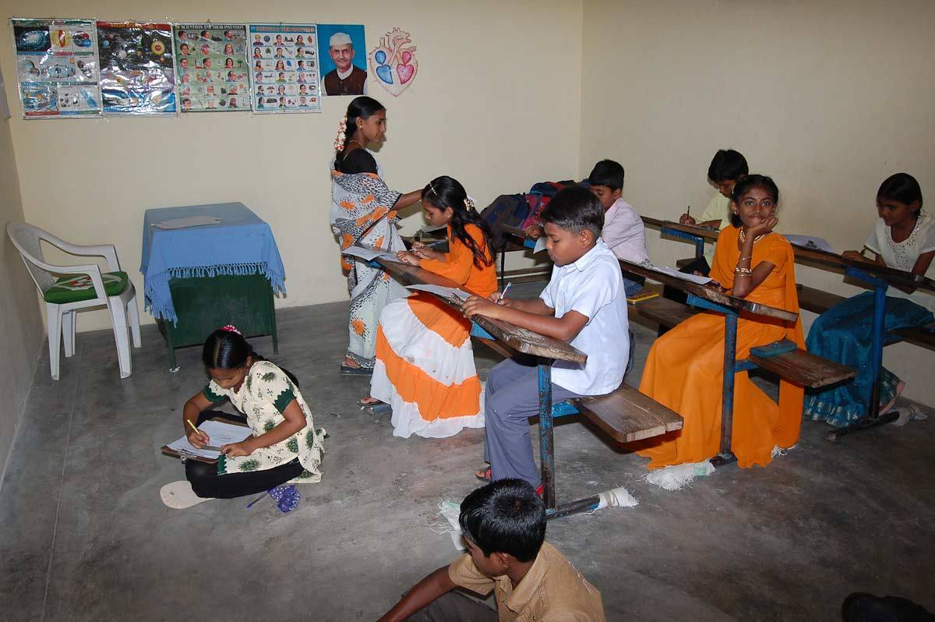
Maximising the Impact
Agra Rotary School, Shamshabad, India

Slide 24

Maximising the Impact
#My Rotary
#Foundation
#Give
#Donate
#Australian Rotary Foundation Trust
www.rotary.org

Slide 25
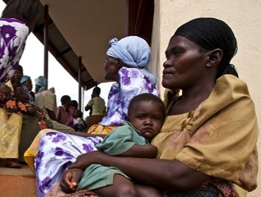
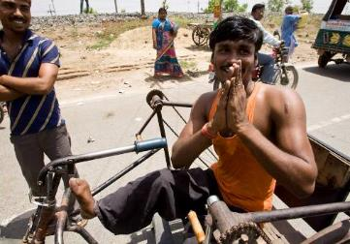
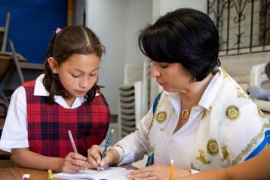
Every Rotarian Every Year
HIV antiretroviral drugs
Mobility for disabled youth
Domestic abuse education
Notes:
These are some examples of what your annual contributions can help provide.
Fourteen anti-retroviral drugs to prevent the transmission of HIV from infected mothers to their babies in Liberia
One bicycle to play sports for youth with disabilities in France
Sexual assault and domestic abuse education for young women in Texas, USA

Slide 26
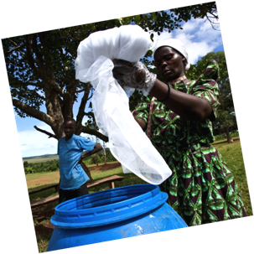
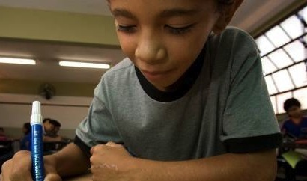
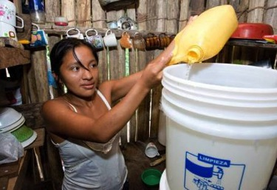
Every Rotarian Every Year
School supplies
Malaria tests
Water-hygiene training
Notes:
Here are some examples of what your annual contributions can help provide:
Three backpacks filled with school supplies for primary school children in Honduras
Fifty malaria diagnostic tests to prevent, diagnose and treat malaria in Mali
One biosand filter and water hygiene training for a family in Peru

Slide 27

Peace & Conflict Resolution
Disease Prevention & Treatment
Water & Sanitation
Maternal
&
Child health
Basic Education
& Literacy
Economic & Community Development

Slide 28
Focus on Peace - RIP Ian Riseley’s Presidential Peacebuilding conferences
Water & sanitation
Economic & community development
Environmental sustainability
and Peace
and Peace
and Peace
Sydney Town Hall - Sat 17 March 2018
Disease prevention & treatment
Peace Fellowships
Maternal & Child health
Basic Education & Literacy
and Peace
and Peace
and Peace

Slide 29
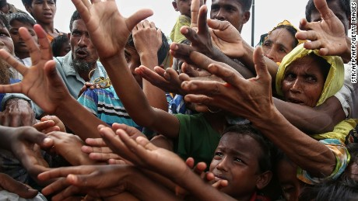
Peace is more than the absence of war ….
…. it is the absence of want.
The Rotary Foundation
‘Doing good in the world’

