Slide 1
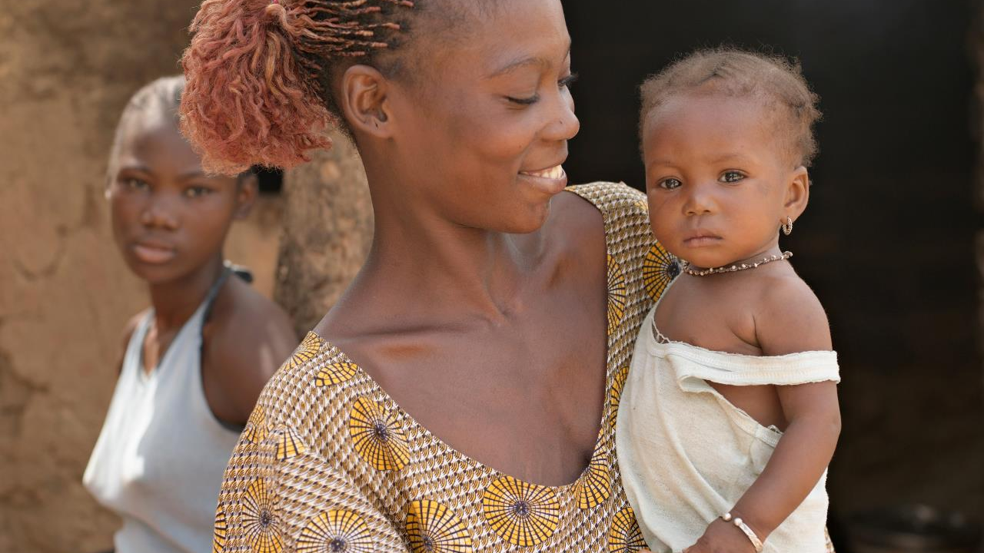
Supporting our
Rotary Foundation

Slide 2
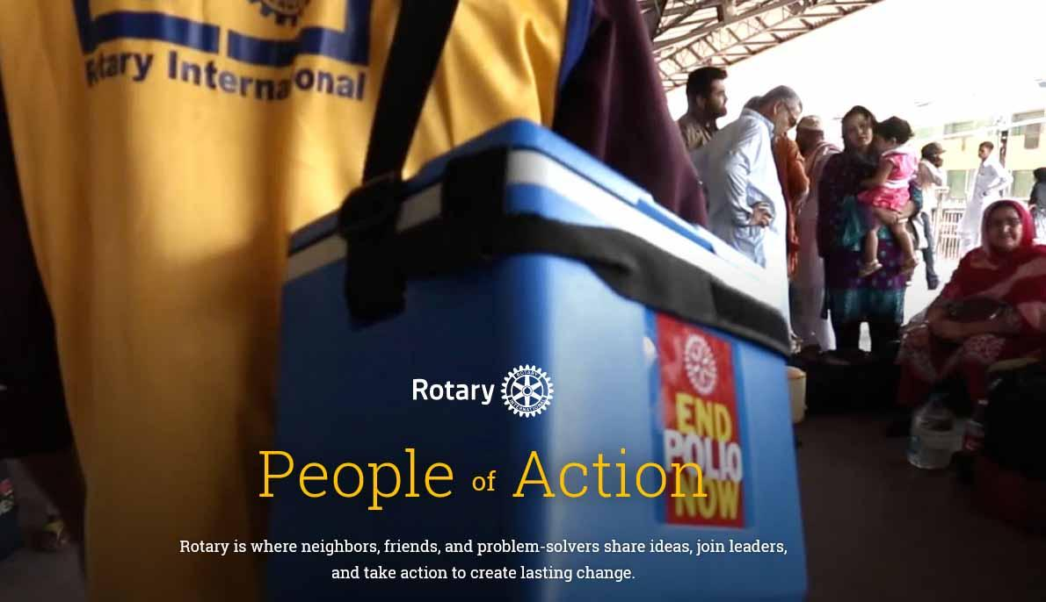

&

Slide 3



Mission
To enable Rotarians to advance world understanding, goodwill, and peace through the improvement of health, the support of education, and the alleviation of poverty.
Endorsed by 2007 Council on Legislation

Slide 4



Slide 5

Strategic Priorities
Increase our IMPACT
Define, measure, track and capture data from service projects to measure our IMPACT, improve project quality and create lasting change
Expand our REACH
Develop new models of engagement to attract diverse Rotary participants and unite them in taking action
Increase our
IMPACT
Expand our
REACH
Enhance our ENGAGEMENT
Create new ways to inspire participants and provide valuable experiences that make them want to stay.
Enhance Participant
ENGAGEMENT
Increase our Ability to ADAPT
Increase our ability to
ADAPT
Make Rotary’s operating and governance structures more efficient, representative, flexible and effective

Slide 6

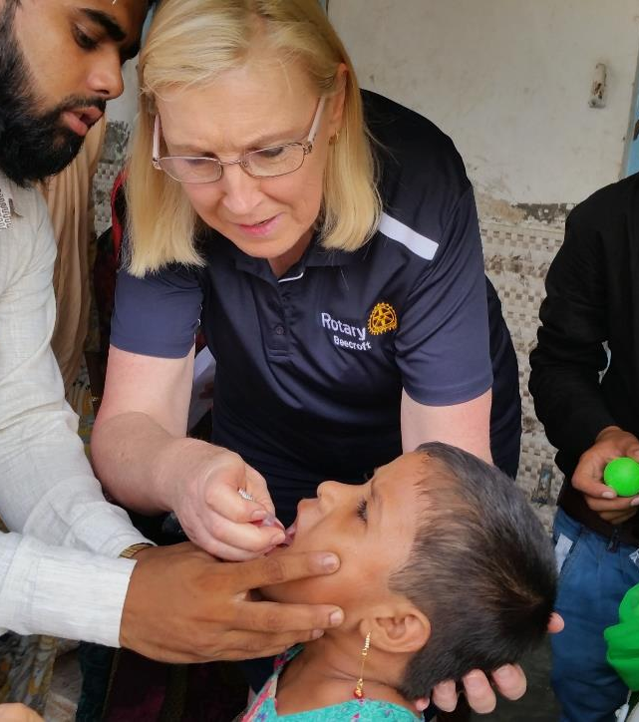
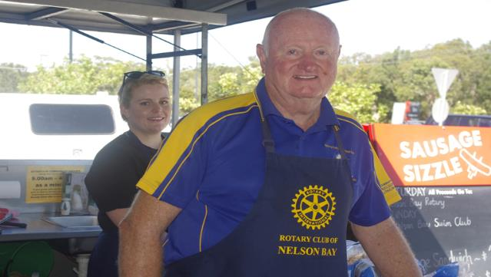
… to enable delivery of service
Do this…

Slide 7
Sausage sizzles are great but
our standing in the community
is built on our IMPACT

Slide 8



The Reputation
Are we a fundraising organisation?
Are we a Humanitarian Service organisation
or

Slide 9


The Reputation
How much of your Club time is devoted to fundraising?
How much of the funds raised by your Club go to Rotary Branded projects?
and

Slide 10



Fundraising to support Rotary Programs and Projects
Building our Brand
Club Projects

Slide 11

Club donates
to another
charity
The negative cycle of fundraising and giving
Charity builds
brand
reputation
Other Charities love the ability of Rotary Clubs to fundraise.
Measure the mail requests your Club gets from other charities.
Club
Conducts
Fundraiser
Charity
asks Rotary
Club for more
funding

Slide 12

Develop
Project
Plan
Building the Rotary brand through The Rotary Foundation
Fundraise
Focus on what your Club does and the benefits of doing so.
Every Project to INCLUDE the ROTARY Name.
Perception change to ROTARY doing!
Identify
Community
Need
Deliver
Project
Measure
Impact
Publicise
and Grow
Rotary
Reputation

Slide 13

Fundraising in the Not for Profit and Charity sector
in Australia
Rotary Clubs and Rotary Entities raise an estimated $100m per year in Australia
The Charity and Not for Profit Sector raises over $11b* from donations and bequests
The Charity Industry
The Federal Government funding to the Not for Profit Sector is over $110b per year.
Government funding for Not for Profit Sector
*Charity Aid Foundation

Slide 14
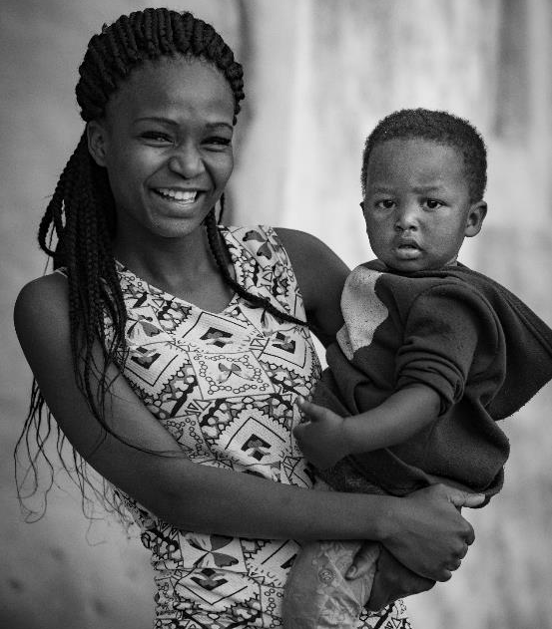

Charity Support
On average, 66% of Australians give to charities with average donation of $106 per charity(CAF*, 2019).
IMAGINE what we could do if all Rotarians were to make
  their charity of choice!
*Charity Aid Foundation

Slide 15


















Donors support and contribute to lots of Charities
Our Charity
Rotary International has one official Charity

Slide 16


Growing your Club IMPACT in your community
Fundraising effort
Ideas, manpower,
compliance
Raise for
Rotary
Membership
return
Being a fundraiser
for other charities
$

Slide 17

Today’s Donors RELATE TO
“Causes”
The Rotary Foundation has SEVEN CAUSES that resonate with today’s donors.
To grow our fundraising we need to expand our donor base within Rotary and beyond Rotarians.

Slide 18


The Fundraising Plan
The Spending Plan

Slide 19


Rotary Fundraising
Rotary has FOUR Funds that you can contribute to
1
2
Annual Fund
Endowment Fund
Funding the projects and scholarships of
The Rotary Foundation.
Funding the World Fund to support the DDF for Global and District Grants as well as projects at the Trustees discretion
3
4
Polio Fund
Disaster Fund
Directly funds our highest priority project
Enabling grants of US$25,000 for rapid disaster recovery

Slide 20
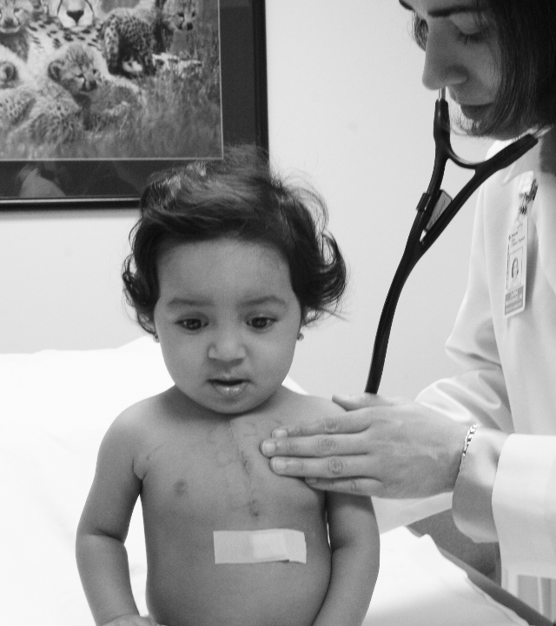
IMPACT
100 new Centurions per District
100 new Paul Harris Society
members
100 new Major Donor Recognitions
100 new Bequests
100 people beyond each Rotary Club
to contribute $100

Slide 21


IMPACT
1.2m Rotarians x $100
Equals
$120,000,000

Slide 22

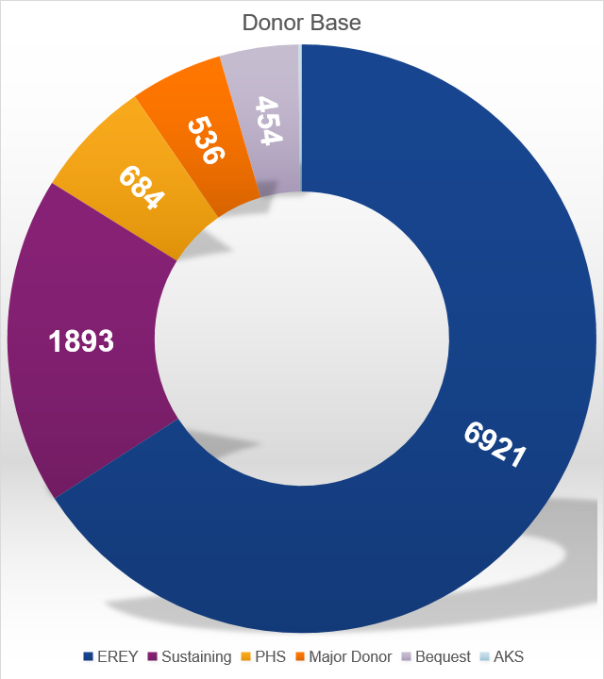
IMPACT
Growing our donor base by 100s during the R100 year
Baseline for each Category is set as of 30 June, 2020

Slide 23


IMPACT
Centennial Year
EREY (Centurion)
Growing this program by 100 members per District.
Imagine the IMPACT we can make!

Slide 24




IMPACT
Paul Harris Society
Growing this program by 4 members per District, will deliver an additional $100K in Foundation contributions every year

Slide 25



IMPACT
Major Donor
Growing this program by 100 members across the Zone, could deliver an additional $1,000,000 in Foundation contributions this Rotary year.

Slide 26







IMPACT
FOREVER
Last Million Dollar Dinner
Bequest Society
By making a Bequest you are securing the future spendable earnings to deliver projects beyond your lifetime.

Slide 27
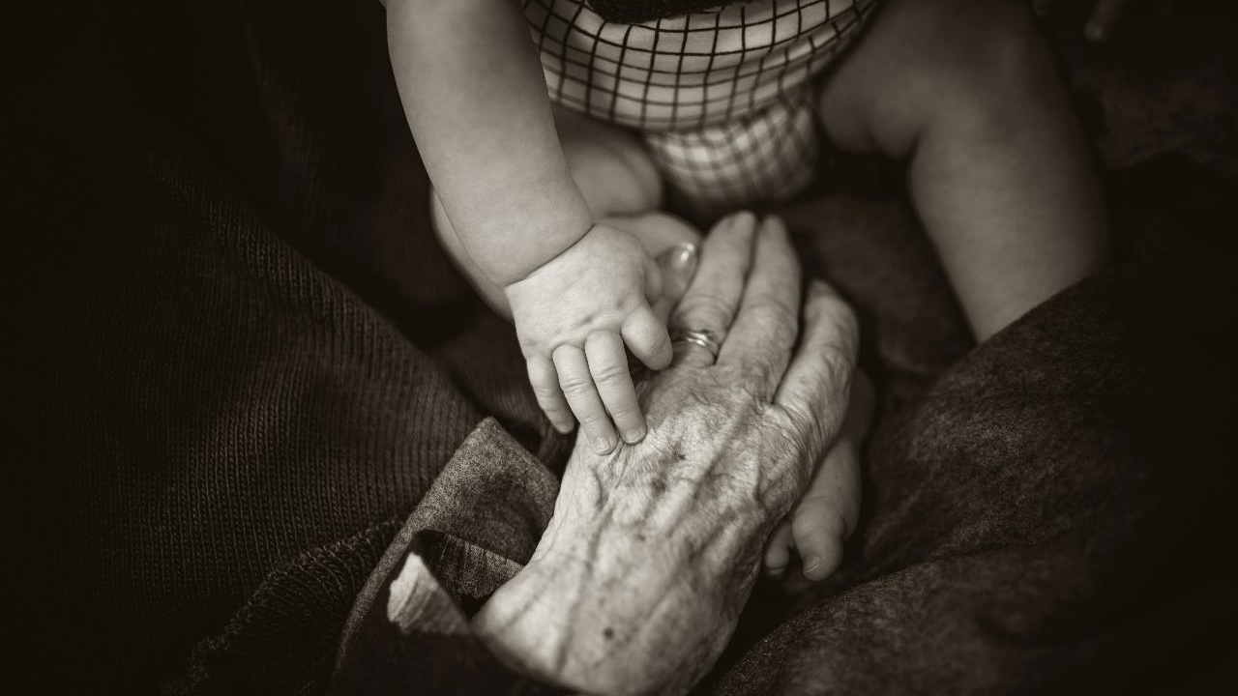
Leaving a bequest
Funding Rotary's impact forever

Slide 28

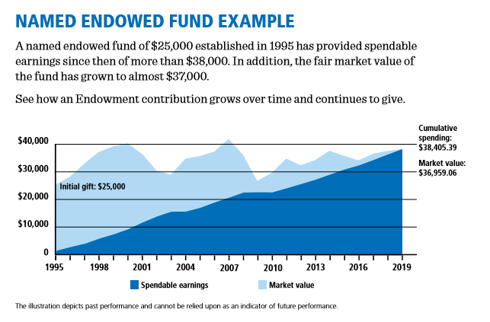

Slide 29
IMAGINE
What IMPACT we could have in
ENDING
POLIO

Slide 30
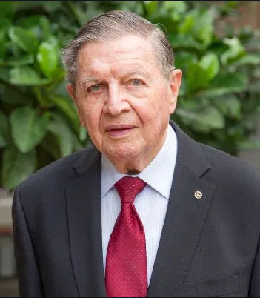

Sir Clem Renouf Polio Appeal
Special appeal to raise funds for
END POLIO NOW
in recognition of the outstanding leadership taken by Past RI President, Sir Clem Renouf, in launching this global initiative.
Contributions to Polio also earn Foundation
recognition points.
Every Club Every Year – ^{US}$1,500

Slide 31

Annual Fund
RYPEN
Endowment Fund
Spending Plan
Rotary Youth Exchange
District Grant
Building Rotary Brand Reputation
Disaster Fund
Global Grant
Polio Contribution

Slide 32


The value proposition of delivering Rotary Branded Projects
Rebuilding our Public Awareness
We enhance member ENGAGEMENT
We expand our REACH
We increase our IMPACT
We demonstrate our ability to ADAPT

Slide 33







Highest Rated Charity
Rated in the top 10 in the world
Stewardship
World Fund
Match
Strict reporting processed in place
DDF matched
The multiplier effect
Rotarian
Engagement
Sustainability
Planning and technical support
Delivering long term community outcomes
Community
Assessment
Low
Administration
Projects based on NEED, not perception
9% for Administration and Fundraising cost

Slide 34

Action Plan
Promote our Causes (Areas of Focus) as the reason to give
Encourage recurring giving
  Annually
  Quarterly
  Monthly
Promote the concept of gaining donors beyond the club
Promote the benefits of this type of fundraising
Promote the benefits of the growing DDF to fund club projects.

Slide 35
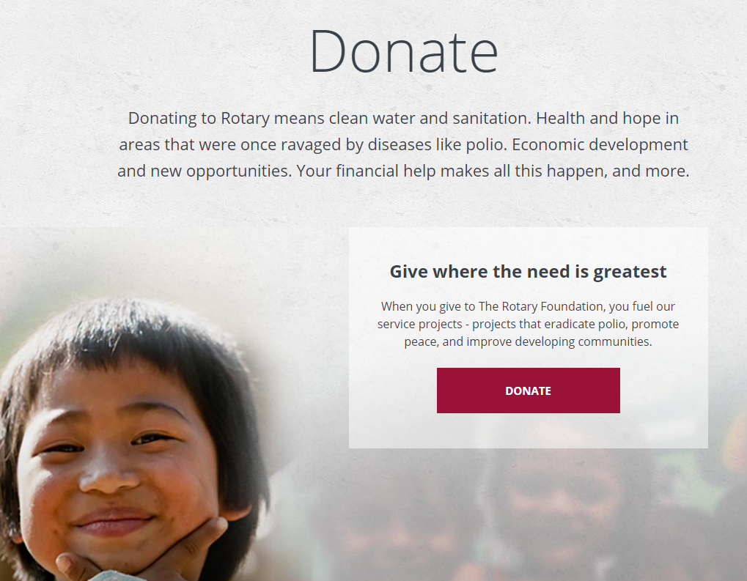
Donor Contributions
Australia
Individuals – login to my.rotary.org and click the Donate button
– select your preferred fund (e.g. polio)
– to receive an AUD tax receipt, specify currency AUD
– make a one-time or recurrent contribution and
– adjust your contributions at any time in My Rotary.
Rotary Clubs – make payments to The Rotary Foundation
– BSB 332-084 A/c 100345225 Ref: RC club name
( Do not write Rotary Club of …… just club name.)
– please email details to risppo@rotary.org

Slide 36
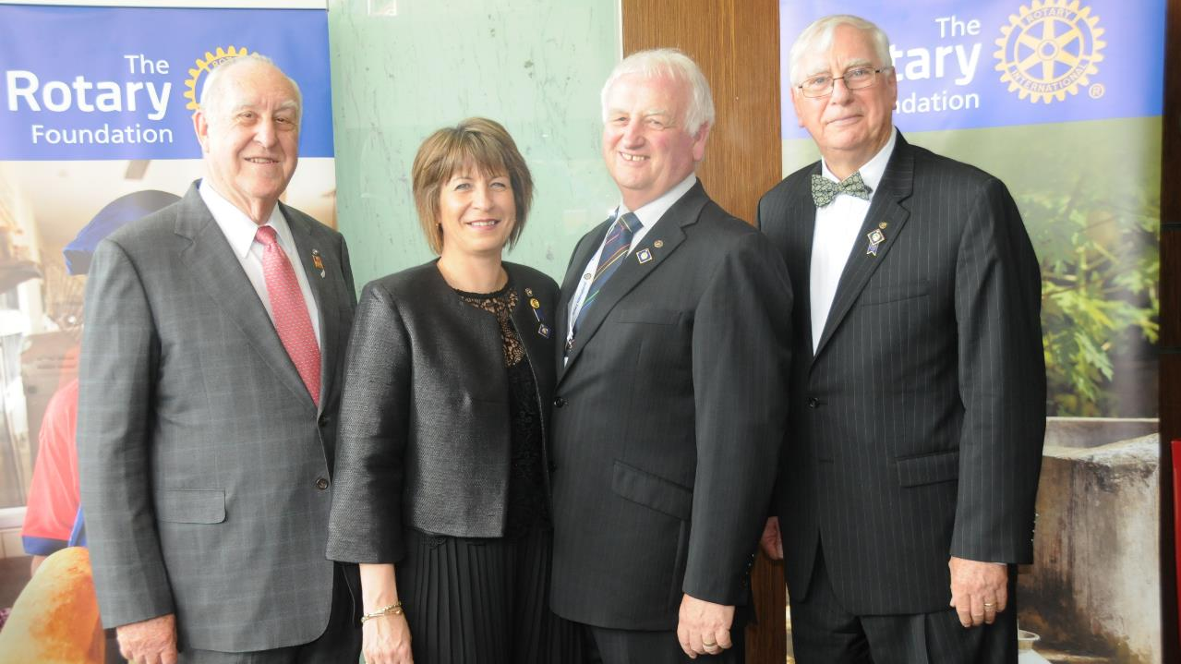




We love to recognise our donors
With special Recognition
events
Subtitle/More Information

Slide 37







Donor Recognition Program
Recognising your Personal Contributions
Major Donor 05
Arch Klumph Society 06
Person cumulative contributions of ^{US}$10,000
Highest level of recognition In Australia with 21 members.
Paul Harris Society 04
EREY 01
Annual contribution commitment of ^{US}$1,000.
Every Rotarian Every Year
$25 to $100
Paul Harris Fellow 03
Centurion Program 02
One off , or cumulative contributions to ^{US}$1,000
Annual contribution of $100

Slide 38






Fundraising Goals for 2021-22
Supporting the Rotary Foundation
Centurion Program
Paul Harris Fellow
100% of Club members to contribute on an annual basis.
Contribute ^{US}$1,000 and recognise a member of your local community
Paul Harris Society
Ending Polio
Every Club to encourage at least one member to commit to this level of support
Commit the Club to contributing ^{US}$1,500 annually.
Annual Fund Contribution
Bequest Society
Commit 15% of total fundraising to annual fund and become a Club Major Donor
Make members aware that they can leave a bequest in their will to keep doing good in the world , forever

Slide 39

Club Foundation Engagement Plan
Foundation Committee
  Club Foundation Chair
    Club Polio Chair
    Club Personal Giving Chair
2. Commit a portion of Clubs Fundraising to The Rotary Foundation
  Annual Fund – suggest 15% of your fundraising.
  Polio Fund – ^{US}$1,500
  Endowment Fund – ^{US}$500
3. Members to become personally engaged supporters
  Centurions – Join through THE JOY OF GIVING or online
  Paul Harris Society
  Benefactors (Bequest Society)
4. Explore opportunities for District and Global Grants
  Attend Grants Seminar
5. Use “Rotary Club Central” as your Clubs Foundation Management tool
  Submit and monitor your goals in “Rotary Club Central”

Slide 40
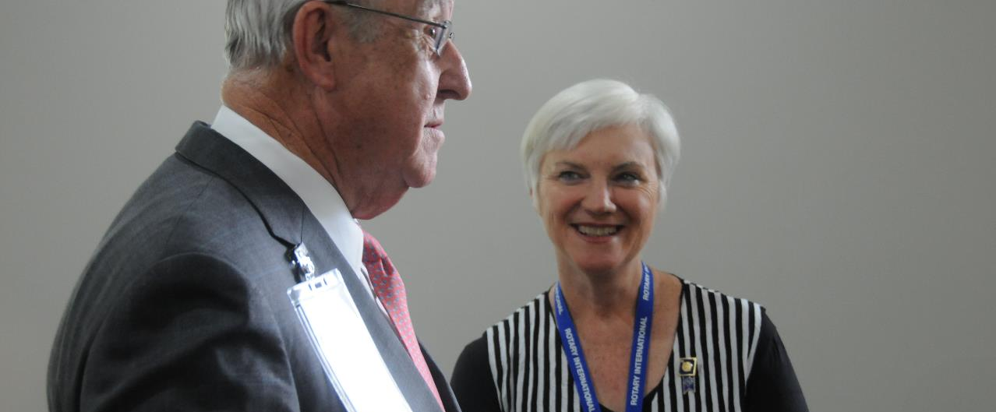
Resources and opportunities
People and Materials

Slide 41
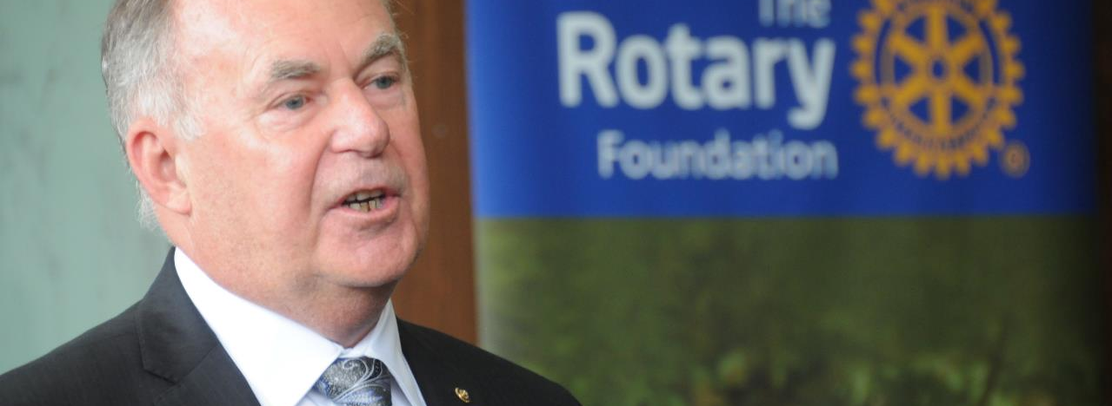
RRFC – Regional Rotary Foundation Coordinator, PDG Peter Garnett
EMGA – Endowment/Major Gifts Advisor, PDG Dennis Shore
Polio – End Polio Zone Coordinator , PDG Bob Aitkin
DRFC – District Rotary Foundation Chair
Annual Fund Chair (District Centurion Chair)
District Paul Harris Society Chair
RFAL (TARFT) – Rotary Foundation Australia Ltd - Directors
RI Staff – Mark Anderson and Rob Byrne
Resources:

Slide 42






Communication pull up banners of our “Causes”
Available – RDU Supplies

Slide 43
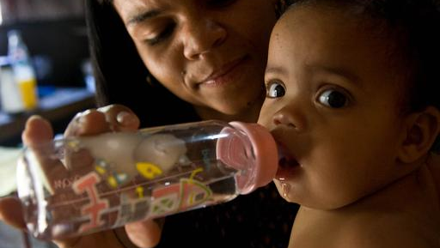
Deliver on our Mission
to do good in the world

Slide 44
QUESTIONS

