Slide 1

The Rotary Foundation
‘Doing good in the world’
PDG Jo Wilkin Foundation Chair D9650
Dorrigo 19 September 2017

Slide 2
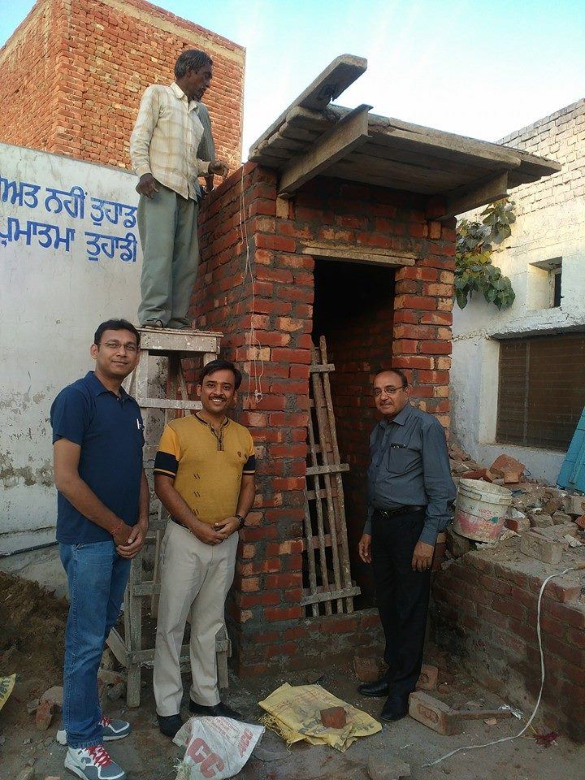
1. What is the Foundation?
2. How is the Foundation structured & how does it operate?
3. How to apply for grants?
4. Why it is good to support
the Foundation
5. How to provide support

Slide 3
What is the Foundation?
Club
Club account
Community account
PROJECTS - ‘Doing good in the world’
International
RI Organisation
The Rotary Foundation

Slide 4
How is the Foundation structured?
PolioPlus
Fund
Annual Programs
Fund
World
Fund
Endowment
Fund
‘SHARE’
Ensures permanent future
Rotary’s
#1 goal
All of Rotary’s other projects

Slide 5
How is the Foundation structured?
Annual Programs
Fund
Endowment
Fund
PolioPlus
Fund
World
Fund
‘SHARE’
Ensures permanent future
Rotary’s
#1 goal
All of Rotary’s other projects

Slide 6
How is the Foundation structured?
Annual Programs
Fund
Endowment
Fund
PolioPlus
Fund
World
Fund
‘SHARE’
Ensures permanent future
Rotary’s
#1 goal
All of Rotary’s other projects

Slide 7
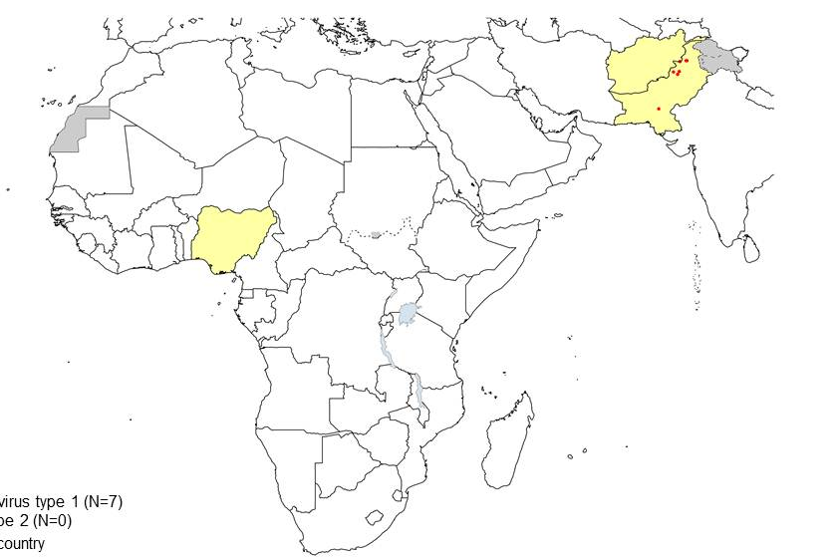
Polio Update
Pakistan - 2014 - 328 2015 - 56 2016 - 20
2017 - 4
Afghanistan - 2014 - 28 2015 - 20 2016 - 13
2017 - 6
Nigeria - 2014 - 36 2015 - 0 2016 - 4
2017 - 0

Slide 8
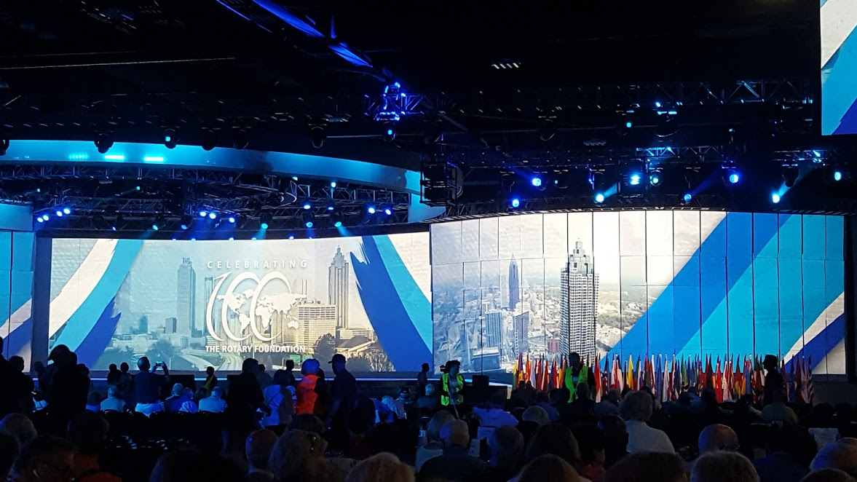
Polio Update – Atlanta Convention

Slide 9

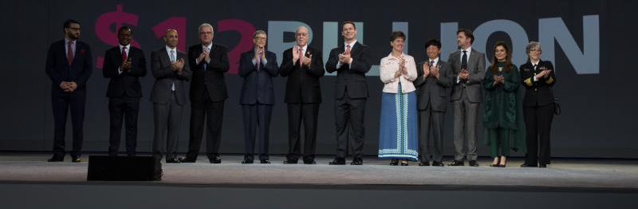
Polio Update – Atlanta Convention
$450 million pledged
$1.2 billion pledged

Slide 10
How is the Foundation structured?
PolioPlus
Fund
Annual Programs
Fund
World
Fund
Endowment
Fund
‘SHARE’
Ensures permanent future
Rotary’s
#1 goal
All of Rotary’s other projects

Slide 11
How is the Foundation structured?
Annual Programs
Fund
World
Fund
Endowment
Fund
PolioPlus
Fund
‘SHARE’
Ensures permanent future
Rotary’s
#1 goal
All of Rotary’s other projects

Slide 12
Using Annual Programs Fund & World Fund to undertake projects
Now only two kinds of grants:
District Grants - small, perhaps up to $4,000
Global Grants - larger, projects costing at least $30,000;
need to have an international partner;
must fit into the 6 areas of focus

Slide 13
How does the Annual Programs/World Fund work?
US $92,000 contributed by D9650 clubs to the Annual Prog Fund in 2014-15
MONEY IS INVESTED FOR 3 YEARS
50%
To D9650
$46,000
50%
To World fund
$46,000
‘SHARE’
District controlled
(District Designated Fund)
DDF
Trustees controlled
Will match
DDF $1 for $1
and
club money 50c for $1
Global
Grants
District Grants
$23,000
Global Grants
$ 23,000
When matched by World Fund this can become $200,000!!
Rollover of $90,000 available

Slide 14
How to apply for grants?
District Grants - forms on District website

Slide 15


Slide 16
District Directory & committees District strategic plan
District committees alphabetical Rotary International president
Directory of District leaders District Governor Elect & nominee
District Governor Assistant Governors 2017-18
Assistant governors Council on legislation 2019
Rotary web links Past District Governors
Documents Library History

Slide 17
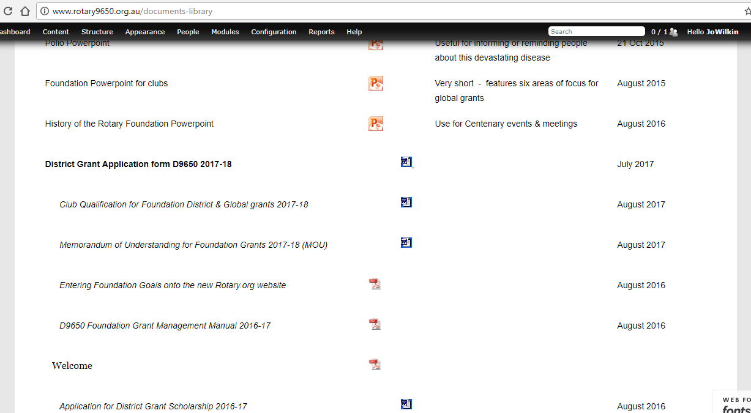
Applications due in by the end of October

Slide 18
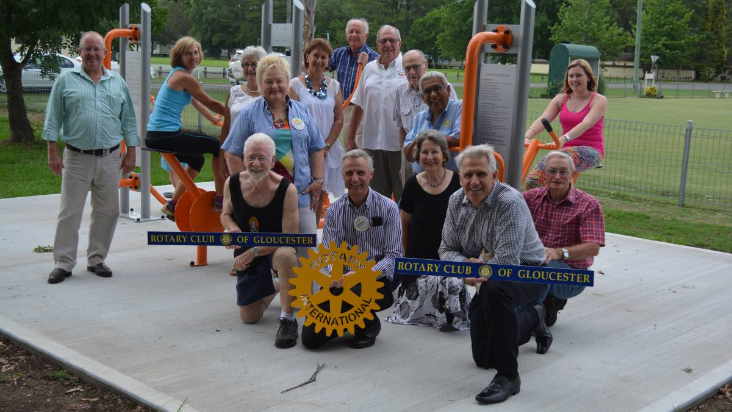
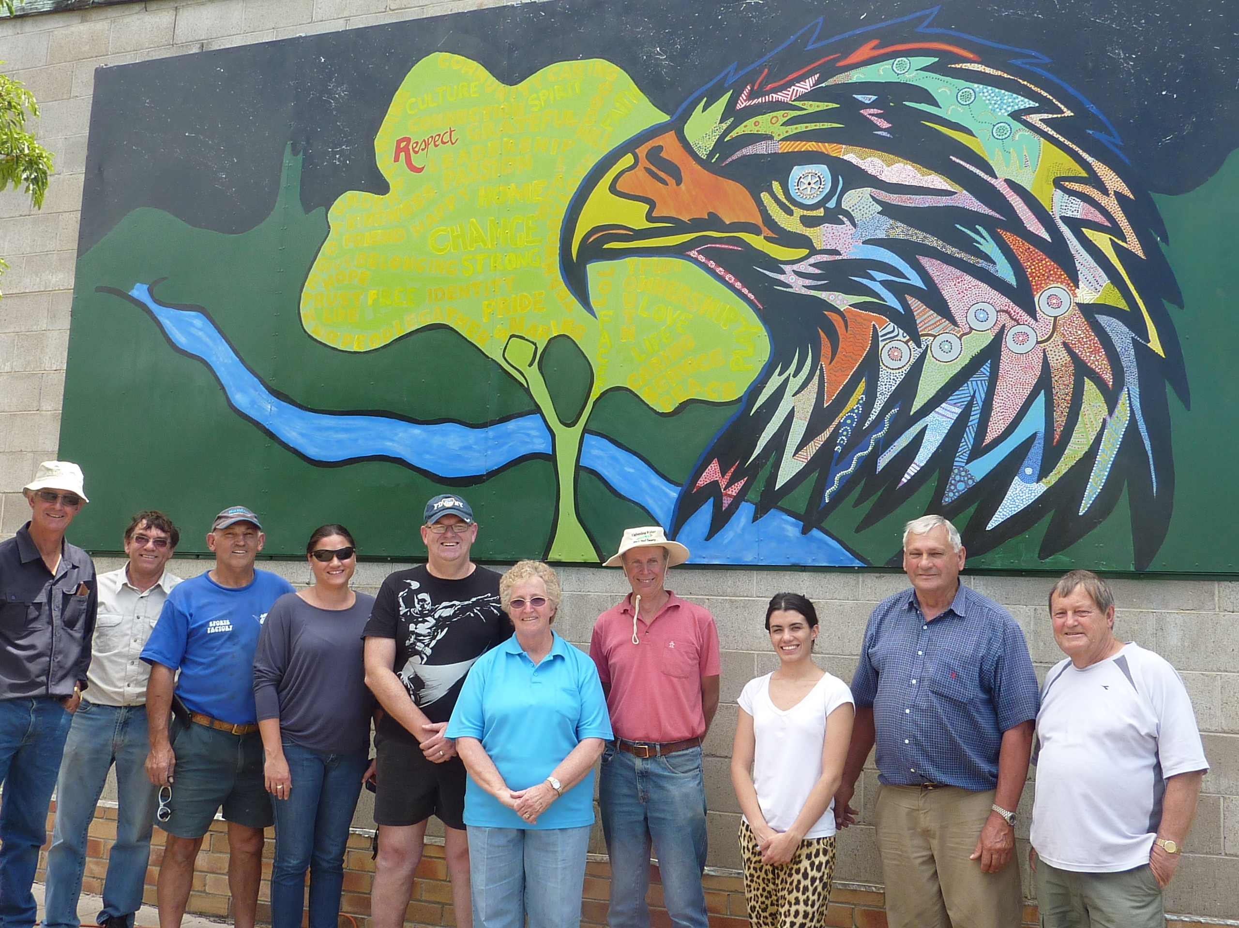
District grants in D9650:
4 Years - 55 clubs
US$180,000 = AU$230,000
80% in Australia
20% O/S

Slide 19
How to apply for grants
1. District Grants - forms on District website
2. Global Grants - forms on RI website

Slide 20
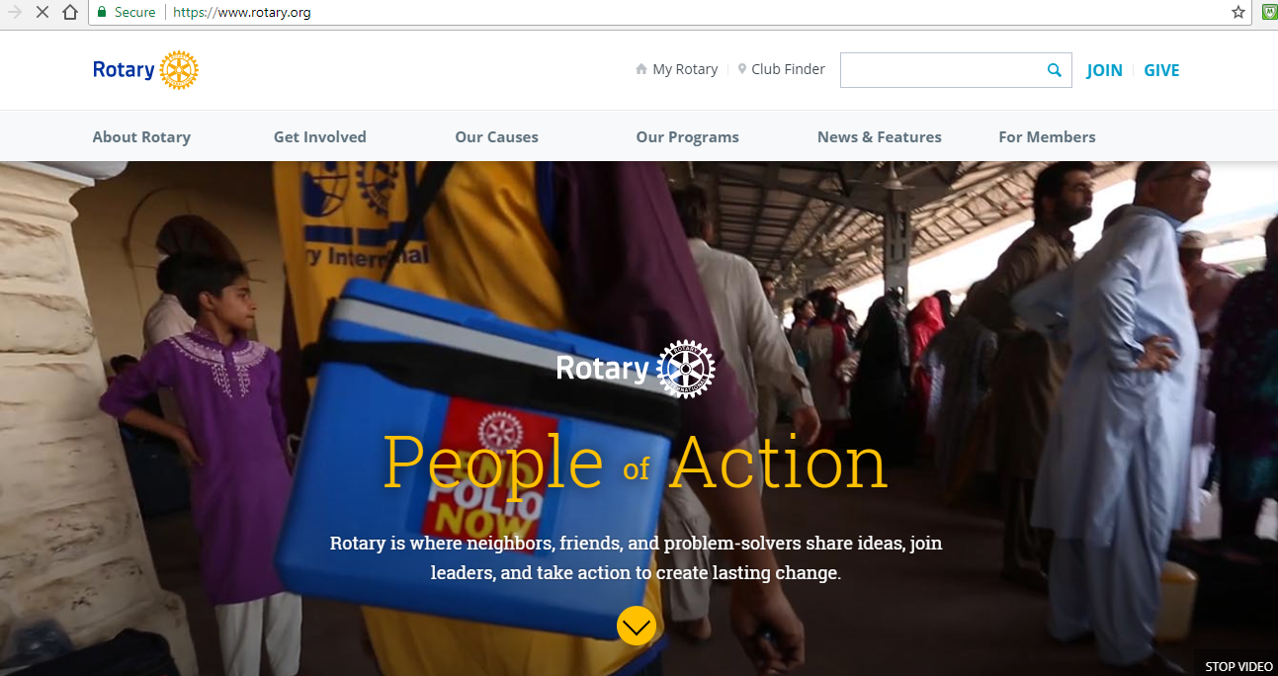

Slide 21
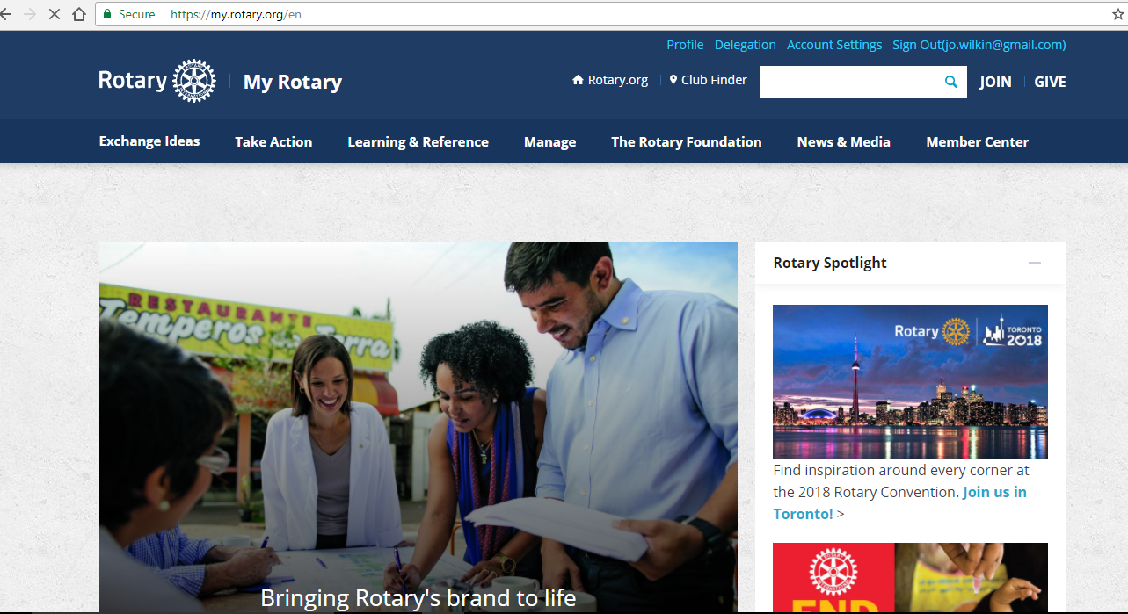

Slide 22
Apply for grants Give About
District grants Ways to Give Foundation centennial
Global grants Planned Giving Foundation reports
Grant center Donor recognition History
Applications any time but approach District committee first to determine how much DDF might be available

Slide 23
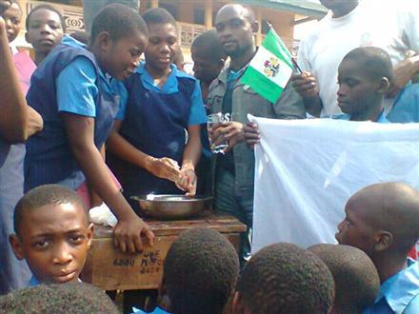
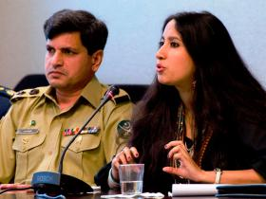


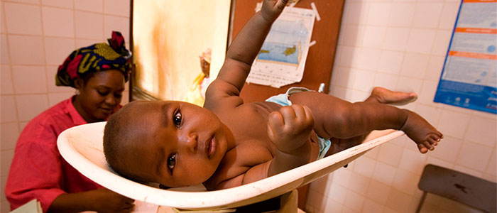
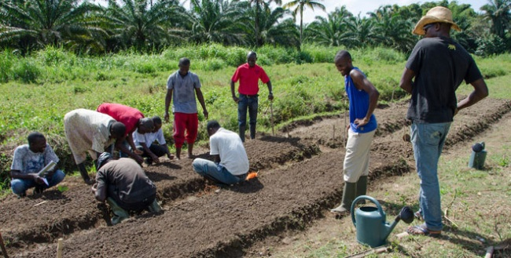
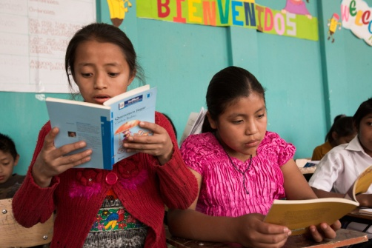
Six areas of focus
Disease prevention & treatment
Water & sanitation
Peace & conflict resolution
Economic &
community devt
Maternal & child health
Basic education & literacy

Slide 24
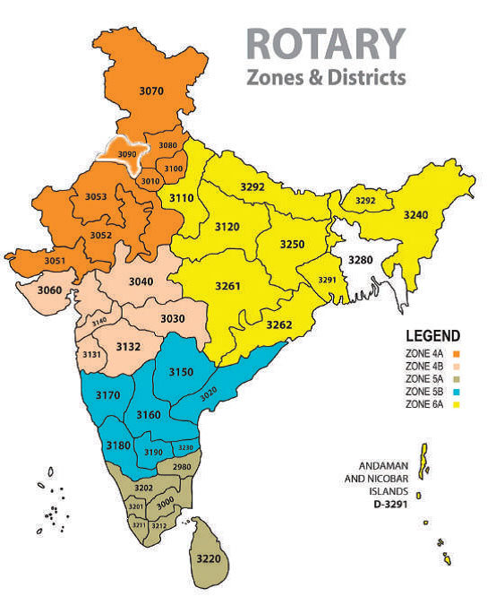
Global grants underway D9650
APPROVED:
ROMAC project - Multi district project
Sanitary toilets for girls in schools in India - Tamworth
Education and sanitation in Kharikola, Nepal - Port Macquarie Sunrise
Ultrasound machine in Brazil - Armidale
Latrine block project in Cote d’Ivoire - Taree on Manning
Vishwa Bharti Rotary School, Shamshabad, India - Renovation Project - Taree North
Potable drinking water in schools in India - District Centenary project
DRAFT:
Medical & Nurse training to Nepal - Port Macquarie
Improving student learning in Fiji - Nambucca Heads
Salam Children’s Home Bali - Wauchope
Maternity Africa Clean water project - Armidale Central.

Slide 26
Online qualification course available soon

Slide 27
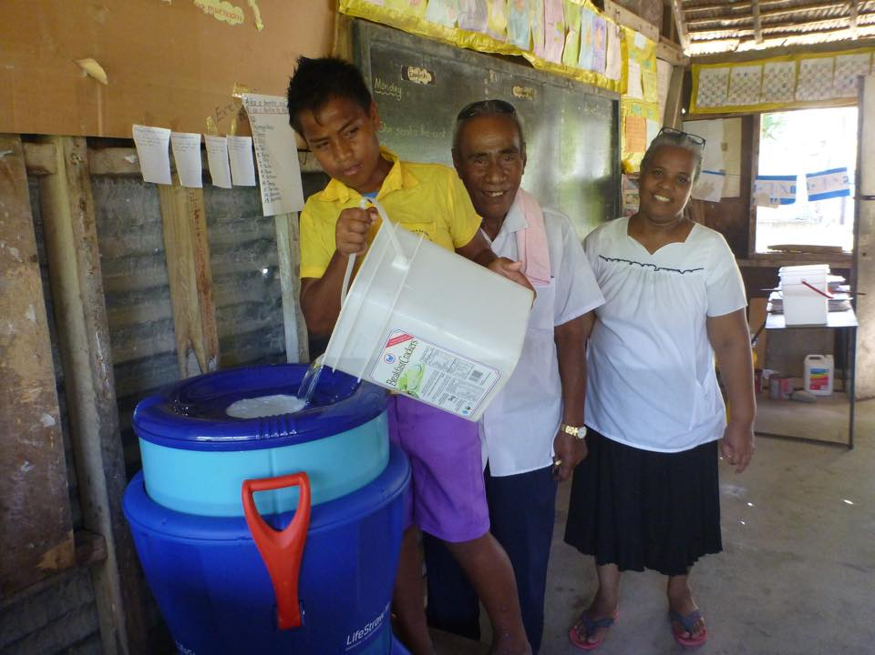
Why we should support the Foundation
1. Highly regarded for effectiveness & transparency
Charity Navigator - 100 pts / 100.
- ‘Strong financial health & commitment to accountability and transparency.’

Slide 28
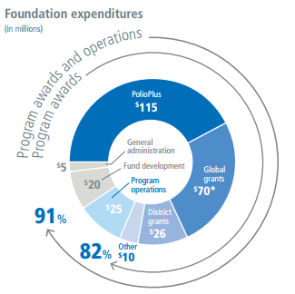
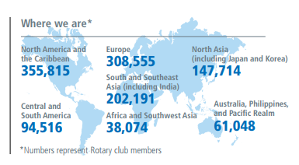
Why we should support the Foundation
2. Low operational costs
8-9% used for admin & fund devt
3 year investment cycle of APF
emphasis on sustainability
volunteer work force

Slide 29
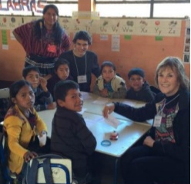
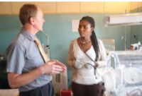
Why we should support the Foundation
3. Cadre of technical advisors
- advise on grant applications
- make judgements on applications
- visit projects in operation

Slide 30

How we can support the Foundation
1. The Centurion Program (Every Rotarian Every Year)
Contribute US$100 per year - to the Annual Programs Fund
Tax deductible via Australian Rotary Foundation Trust
Bank transfer / Credit card deduction
Count towards PHF

Slide 31
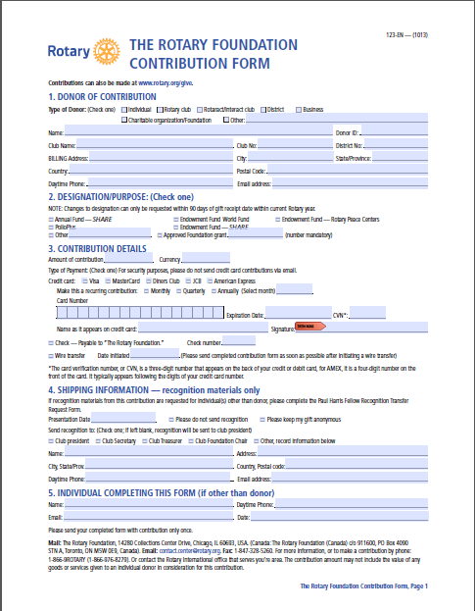
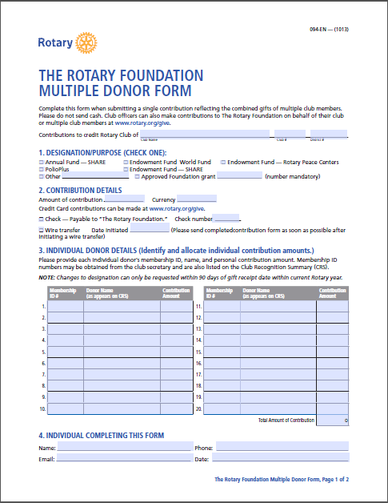
Mark
Annual
Programs
Fund

Slide 32
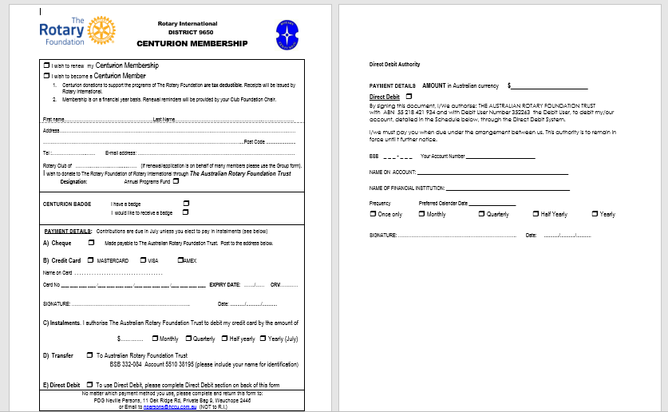

Slide 33
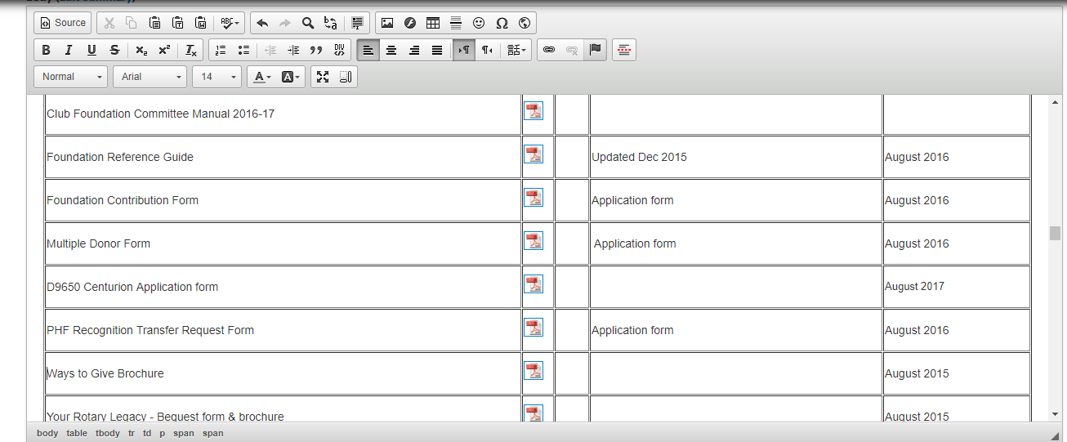
Contribution forms on D9650 Website

Slide 34
Centurion Program 2016-17
D9650

Slide 35
How we can support the Foundation
2. The Endowment Fund

Slide 36
How is the Foundation structured?
PolioPlus
Fund
Annual Programs
Fund
World
Fund
Endowment
Fund
‘SHARE’
Ensures permanent future
Rotary’s
#1 goal
All of Rotary’s other projects

Slide 37

The Centenary of the Foundation - 1917 to 2017
GOAL: Build the Fund towards US $1 billion

Slide 38


Leaving a legacy of hope - Bequest Society
  A Bequest Society member is an individual or a couple who have made a provision in their estate plan to gift a minimum US $10,000 to The Rotary Foundation.

Slide 39
Why support a charity in your will?
1. Pause for a moment and think about the value of your estate
2. A bequest of up to 10% of your estate will have minimal impact on your children or other beneficiaries
3. Your will is your last message to your children
4. Take the opportunity to reinforce your values to them - compassion for others

Slide 40

Celebration!!!
‘Million
Dollar
Dinner’

Slide 41
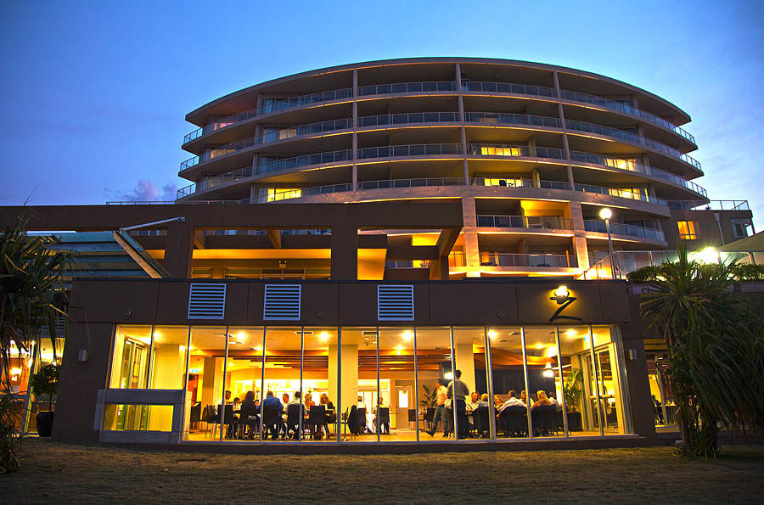
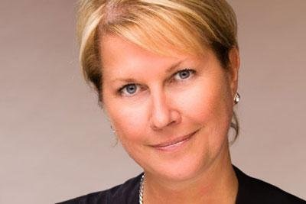
The Million Dollar Dinner –Districts 9650 and 9670 (Hunter)
Sat 18 November 2017 Rydges Hotel Port Macquarie
Jennifer Jones Vice President 2016/17 Rotary International

Slide 42
Anyway, come to our dinner!
All welcome – 250 limit so book now!
Book at http://milliondollardinner.org.au/
Three course meal, pre dinner drinks, plus table wines provided
Presentations to Bequest Society members
Cost: $80

Slide 43
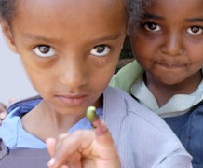
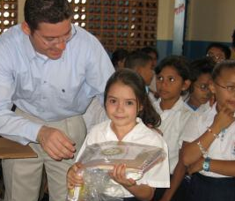
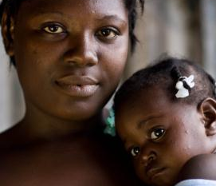

Supporting the Foundation:
PolioPlus
Fund
End Polio Now
Annual Programs
Fund
For Support Today
Endowment
Fund
To Secure Tomorrow

Slide 44

Thank you for
your support!
The Rotary Foundation
‘Doing good in the world’

